Slide 1
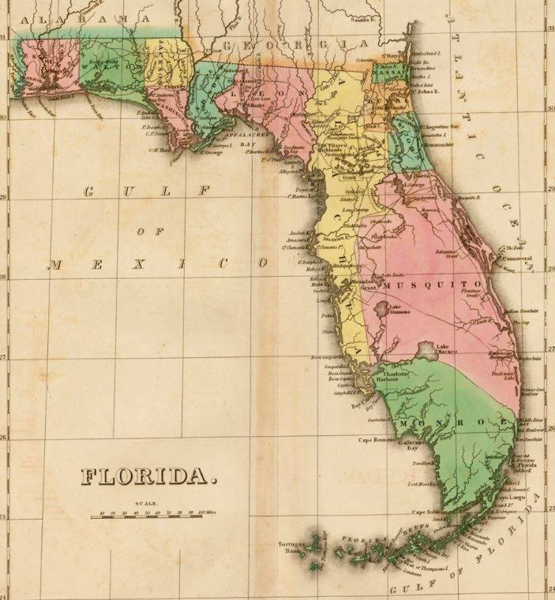
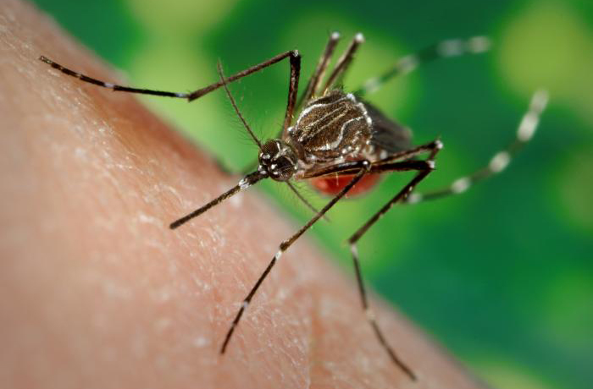
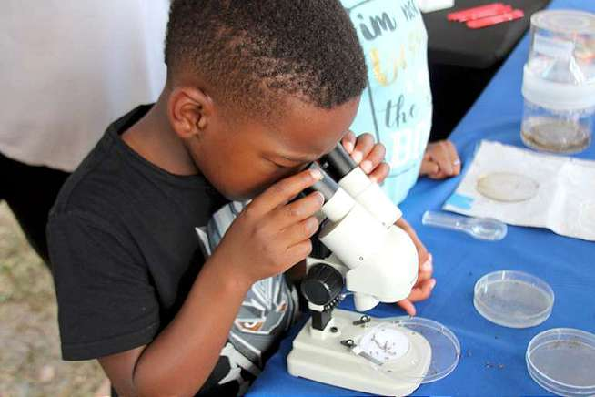
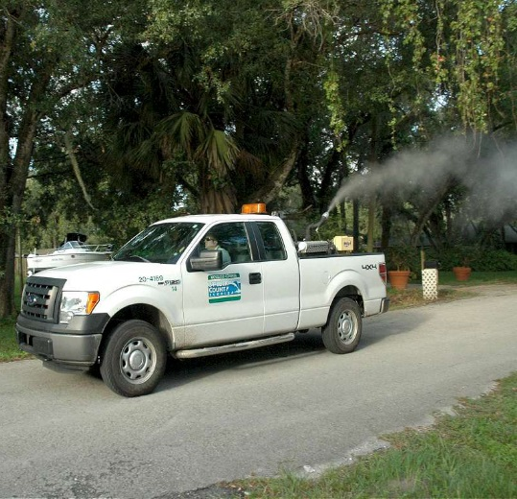
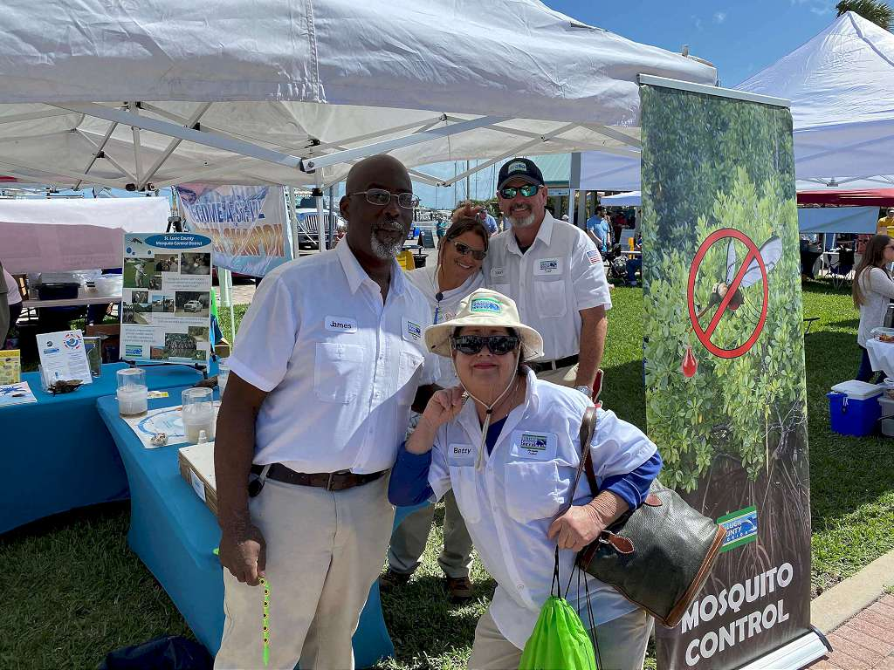
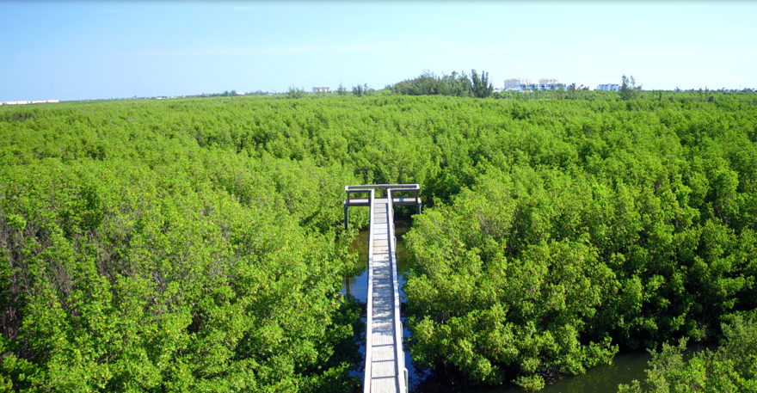
St. Lucie Mosquito Control
Presidents Council Meeting 2021 Presentation
Manager Terrill Mincey

Slide 2
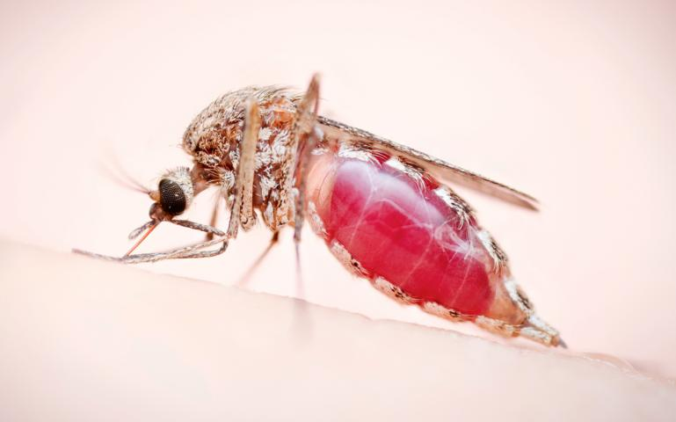
Our Mission Is Protection
The mission of the Mosquito Control District is to reduce the threat from mosquito-borne diseases to public health, curtail nuisance mosquitoes, and improve the quality of life in our community by implementing environmentally safe, effective and economically responsible practices consistent with applicable laws.

Slide 3
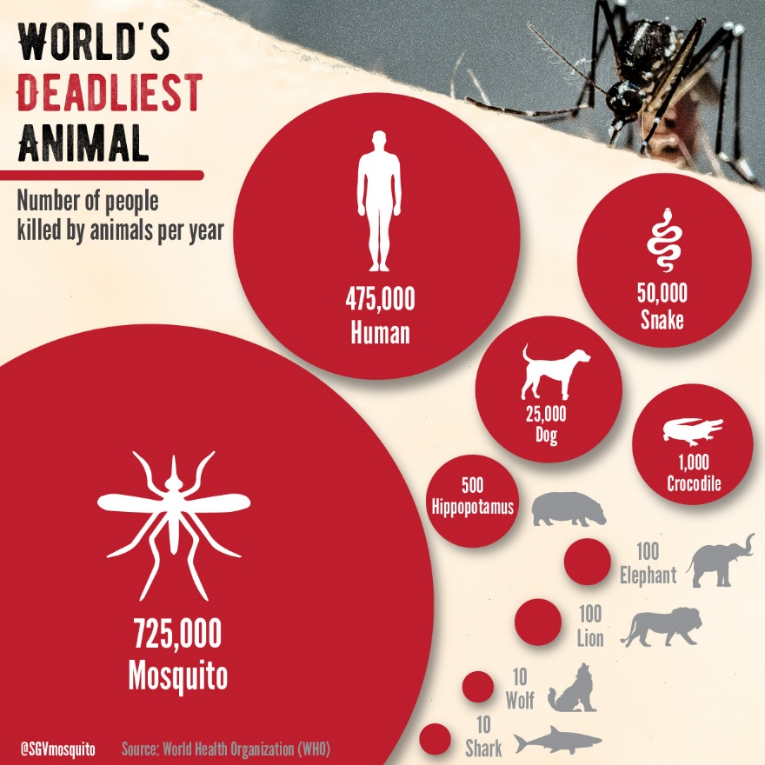
Notes:
Why is this important? BC mosquitoes kill more people worldwide every year than any other animal. While the US and Florida do not have a high number, the ease of travel in this day and age make it easier than ever for someone infected with a mosquito-borne disease to get on a plane or ship and arrive in FP, where all it takes is one mosq to bite the sick person, and then a healthy person, transmitting that disease to another. It’s that easy. And many of those disease not only affect humans but pets and animals as well. We have to be prepared.

Slide 4
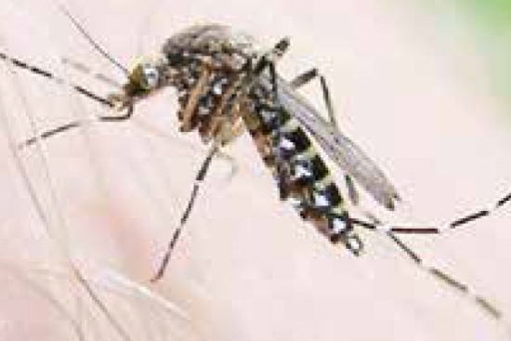
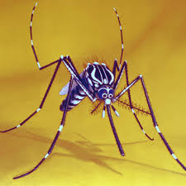
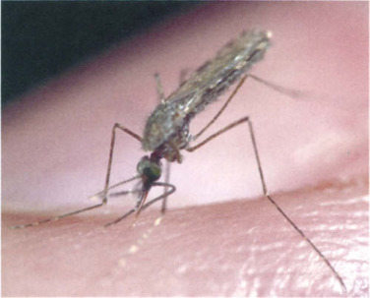
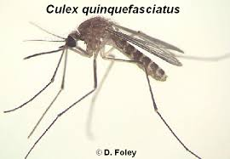
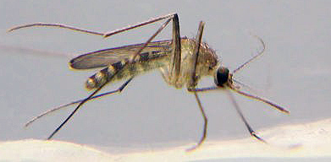
Disease Vectoring Mosquitoes
Aedes
Anopheles
Culex

Slide 5
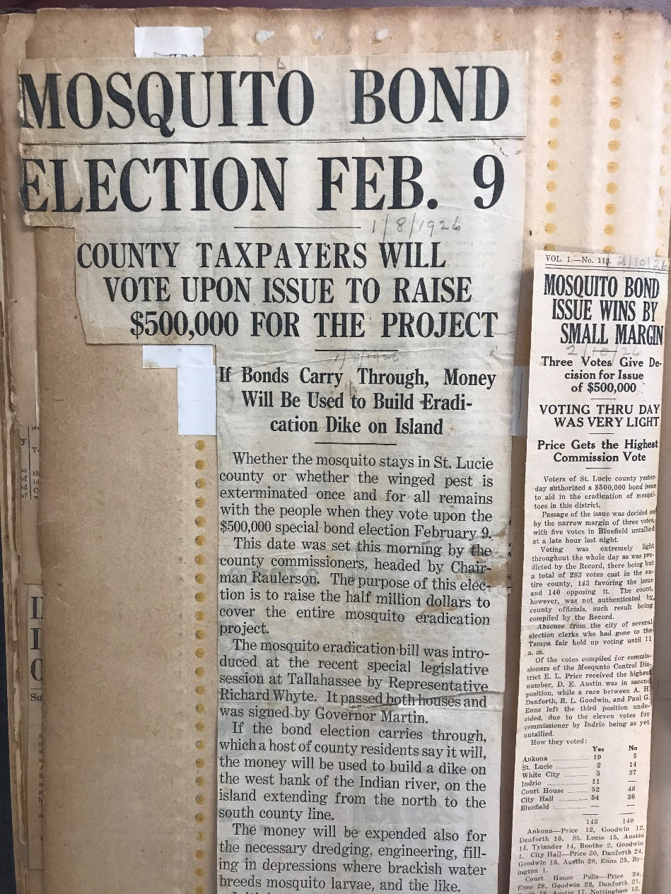
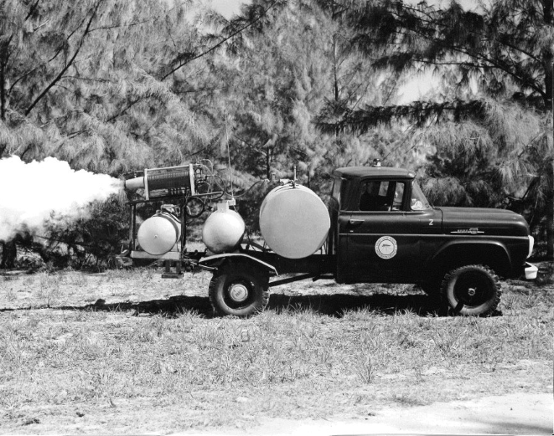
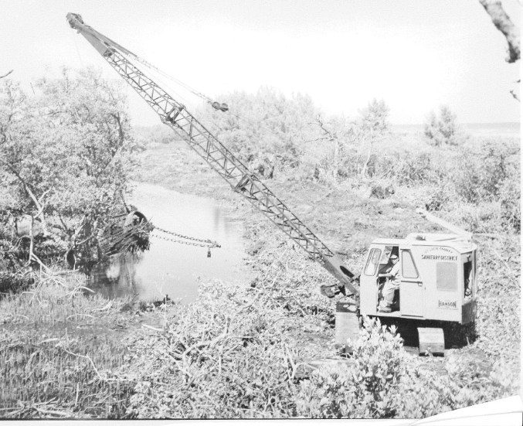
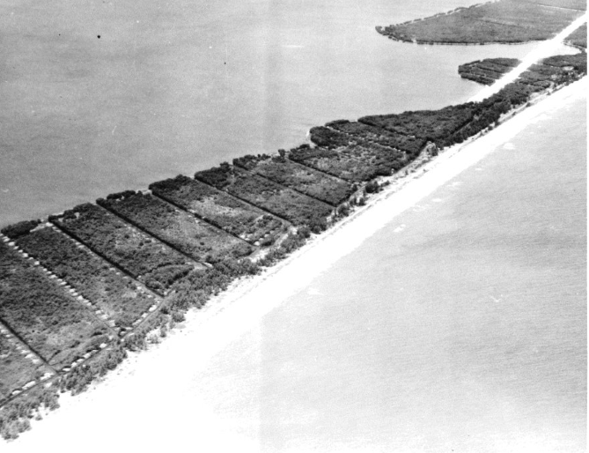
St. Lucie Mosquito Control District
Mosquito control began in 1926
Second special taxing district formed in State
Covers 336 square miles in St. Lucie County, including cities and St. Lucie Village
Notes:
Fortunately, SLC has had a lot of experience with mosq control. This is nothing new for us. We were the 2nd district created in Florida. Scrapbooks shows clipping from the Feb. 20, 1926, News-Tribune where mosq funding was first approved. Those early efforts were primarily focused on creating ditches on Hutch Island, then later on fogging and in recent years, an integrated program with the most modern elements.

Slide 6
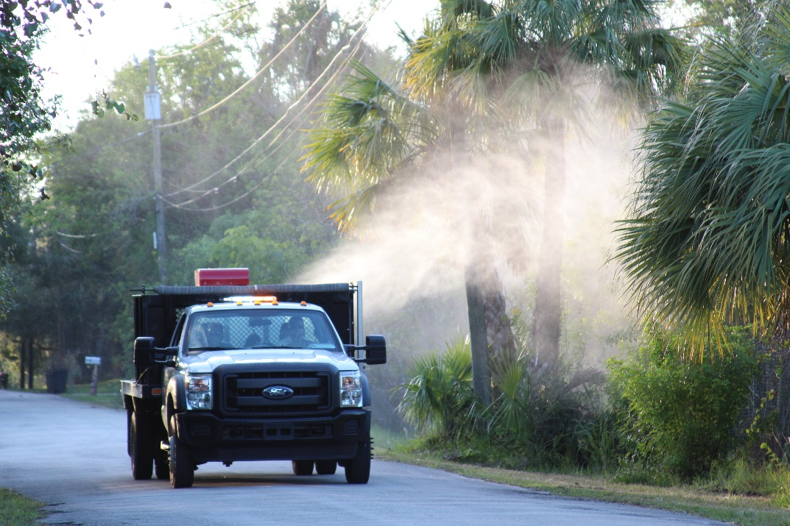
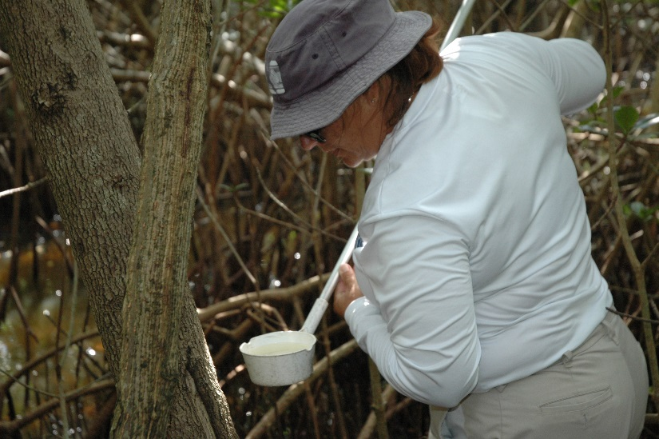
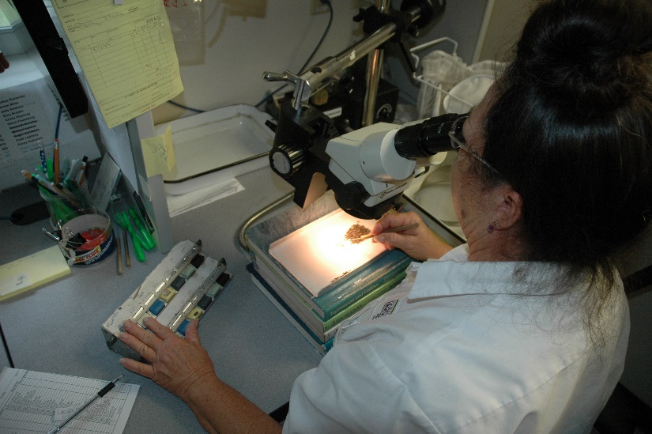
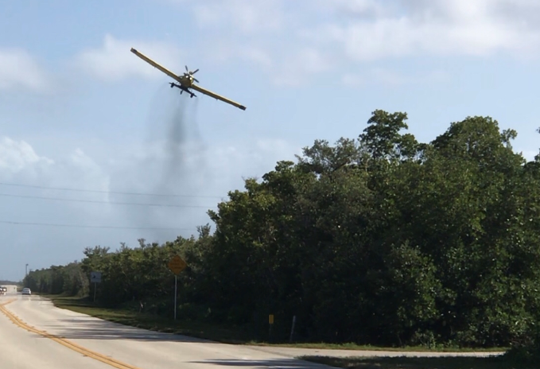
No. 1 Goal: Protect Public Health
38 full- and part-time Mosquito Control employees
Implement an integrated mosquito management approach to mosquito control by adhering to best management practices. This is done through a combination of surveillance, control measures, and public education.
Perform or outsource testing as needed (resistance, product efficacy, equipment efficacy)
Notes:
We have 38 emp. Who perform surveillance, research and treatments – and much more than just the fog-truck operation everyone is most familiar with, that kills adult mosquitoes. Much effort on reducing mosquito larvae, so they never get a chance to reach the adult life cycle. This includes spraying larvicide, which is an organic product, with a high-pressure turbine, inspecting for the presence of larvae in standing water, research on the number of type of species present, and aerial larviciding, again, using a bacteria-based project in granules that are dropped from a plane over mangrove marshes where salt-water mosquitoes grow.

Slide 7
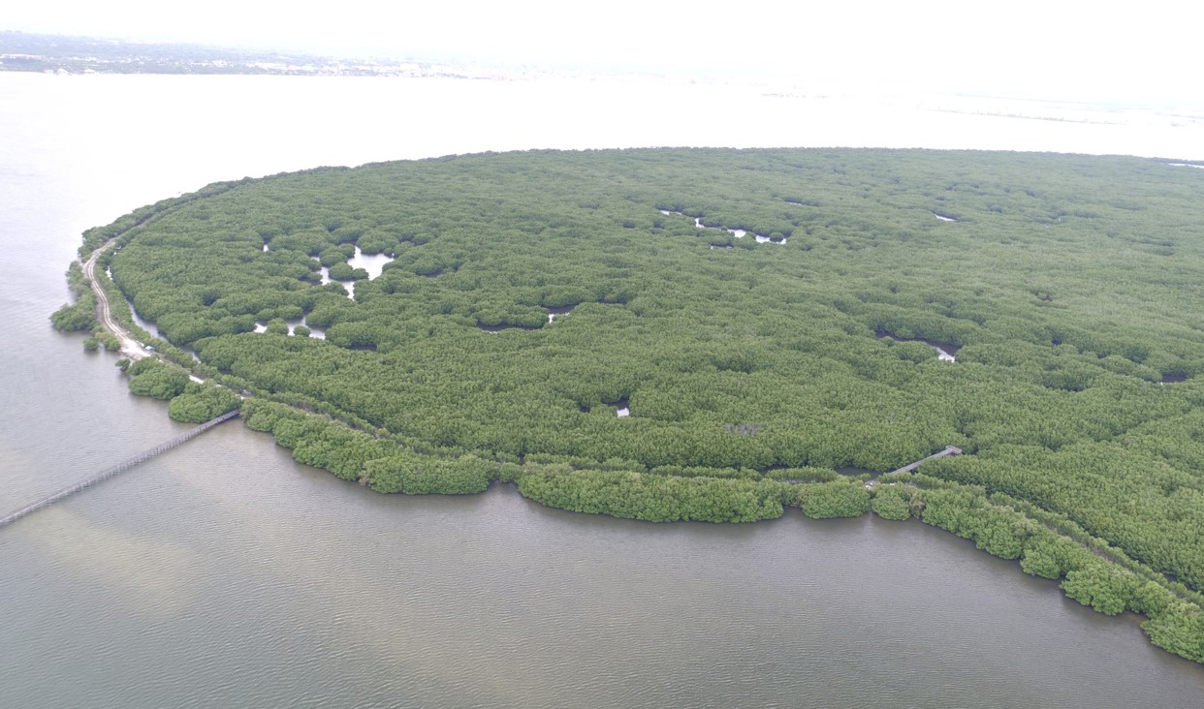
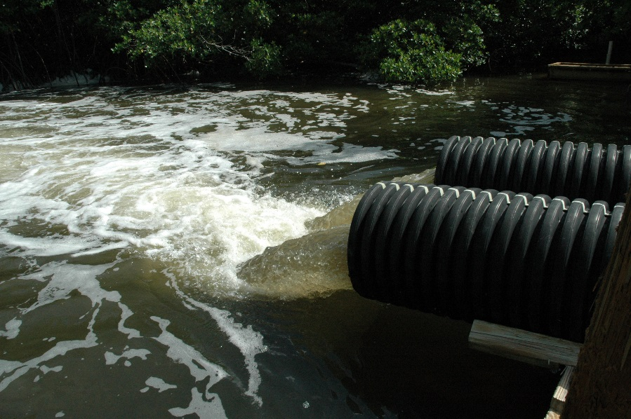
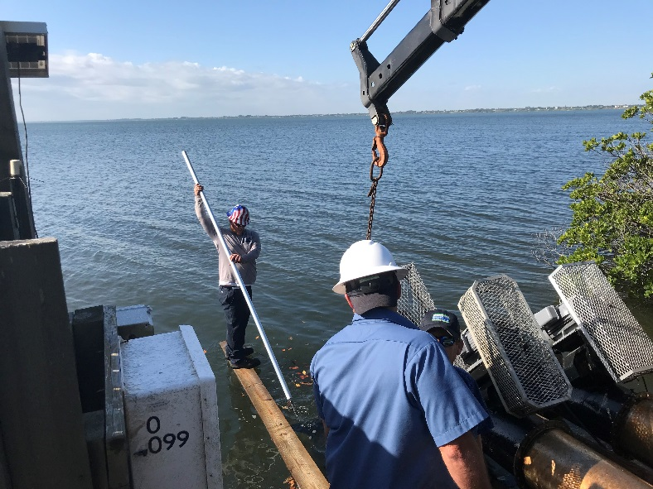
Mosquito Impoundments
Manage more than 4,400 acres of mangrove preserves as a natural method of controlling mosquitoes that reduces dependence on chemical products while boosting marine habitat and improving health of Indian River Lagoon
Notes:
What many people don’t know is that we manage mangrove preserves along Hutch Island as mosquito impoundments, where seasonal flooding reduces mosquito habitat by covering up areas where mosquitoes would proliferate. Not only that, these imps help improve water quality in IRL, serving as marine nurseries. Many are open to the public as rec. areas.

Slide 8
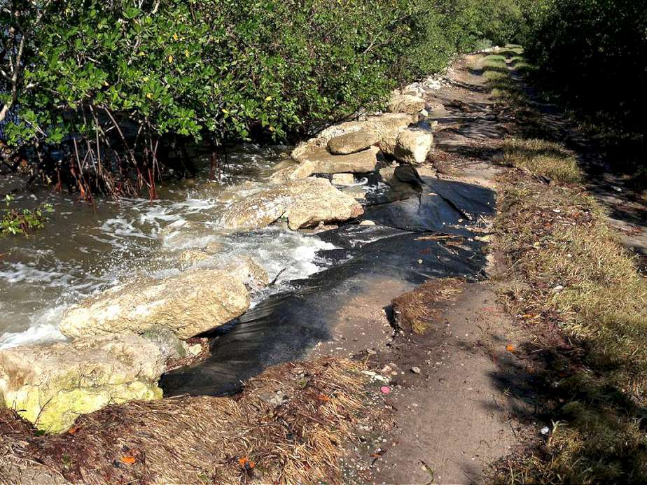
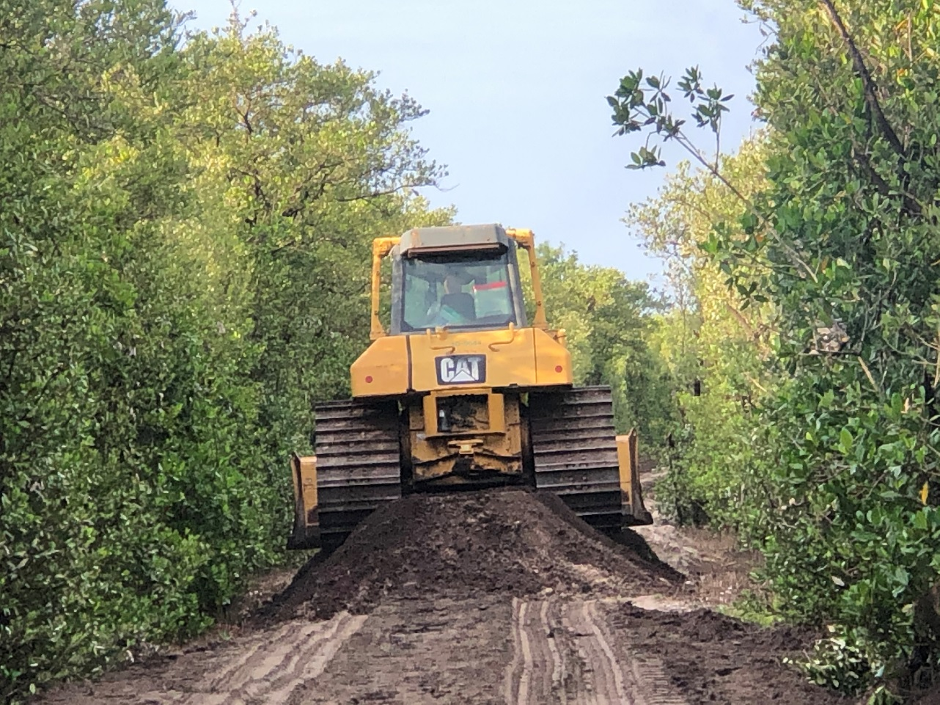
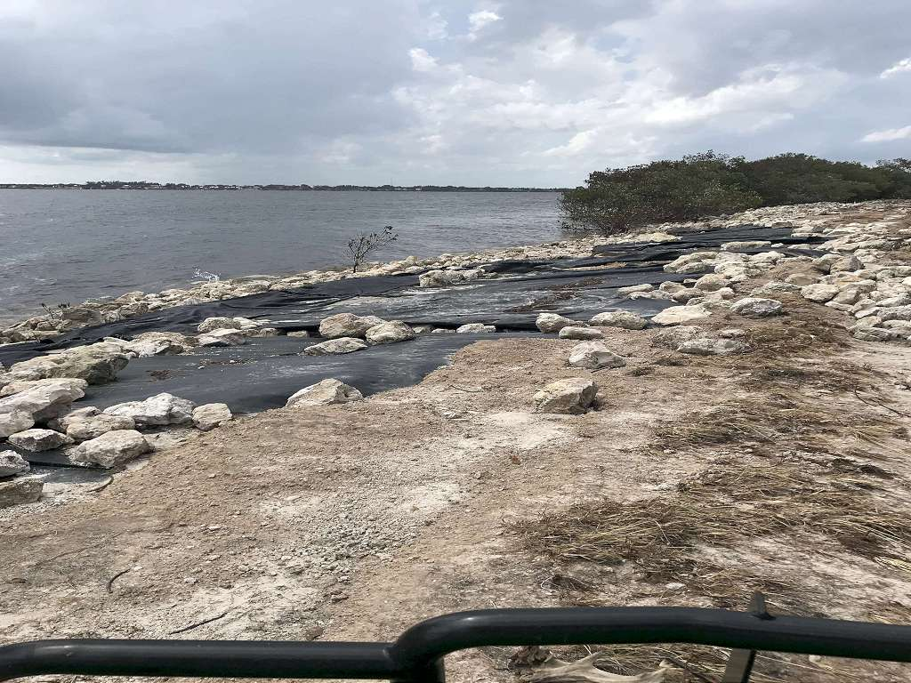
Rising Concerns Over Rising Seas

Slide 9
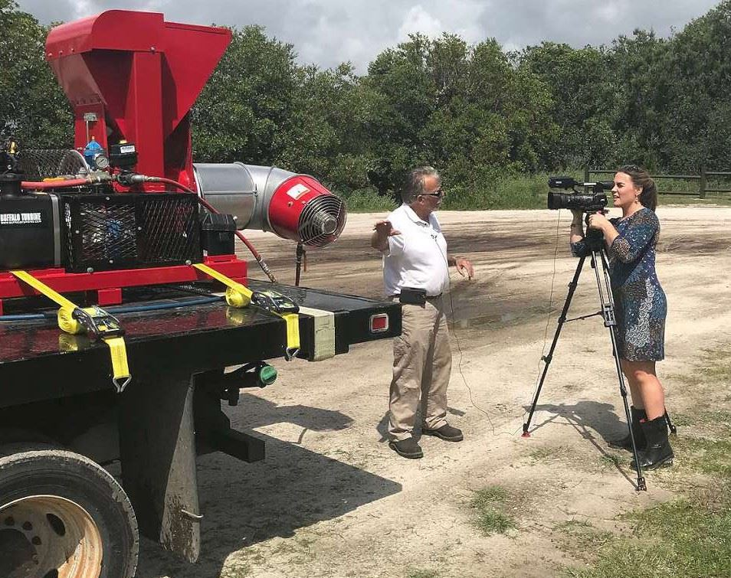
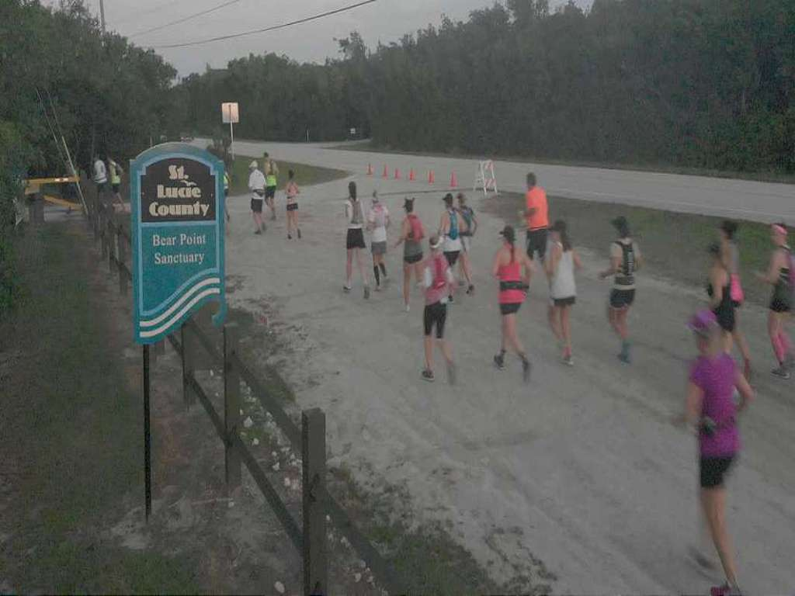
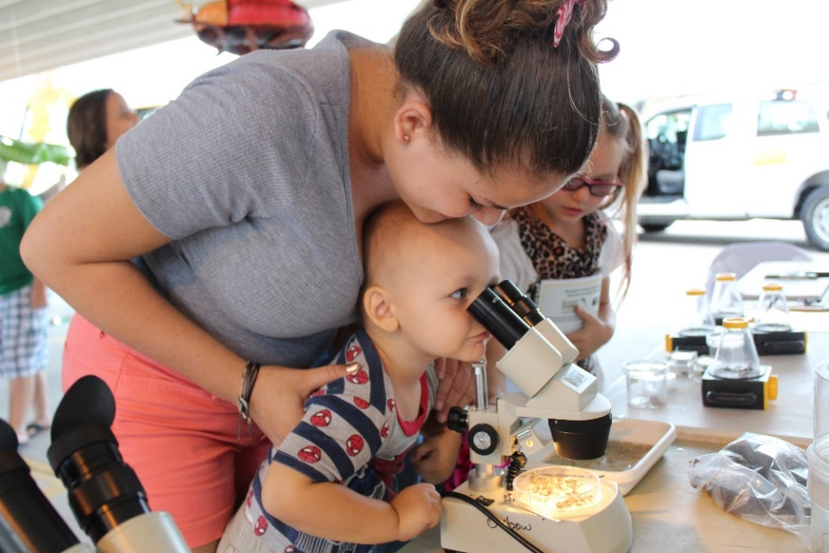
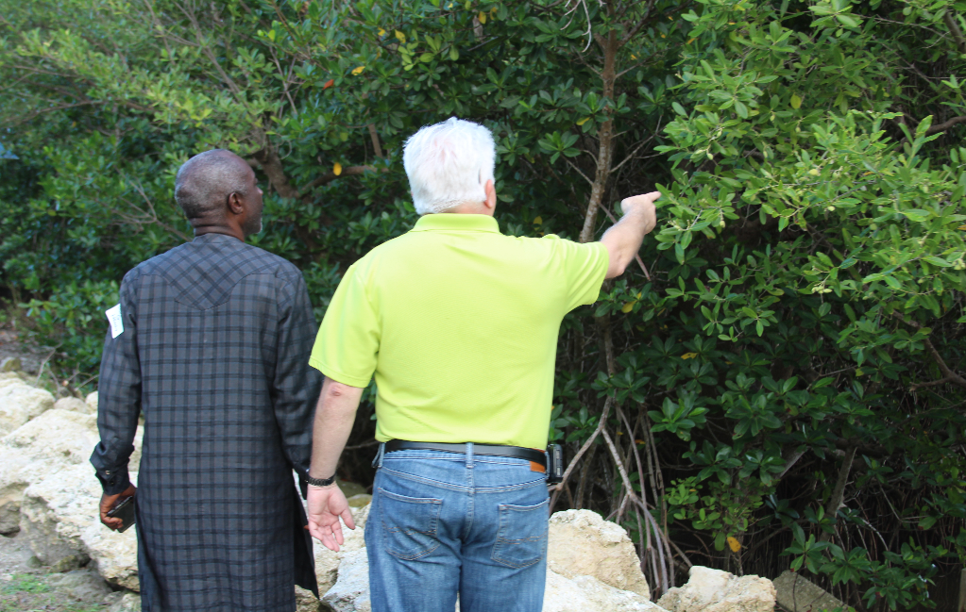
Education & Outreach
Festivals
School Programs
Summer Camps
Oxbow Exhibits
Media Reports
Skeeter Skoot

Slide 10
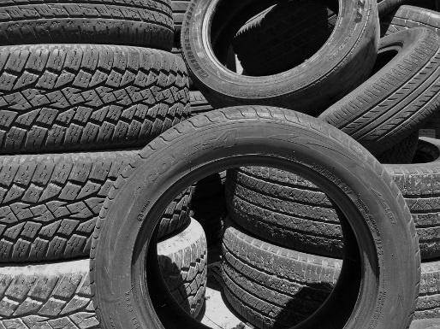
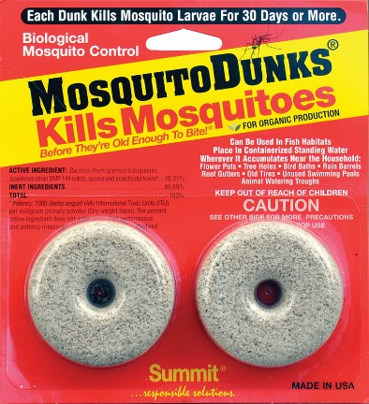
Public Involvement is Crucial
Toss out standing water, and change water in pet bowls and bird baths at least once a week
Discard old tires, pans, tarps, appliances and other unneeded items that collect water
Use biological control of larvae in standing water, artificial containers, and natural containers (bromeliads).
Keep mosquitoes out of your storm drains

Slide 11
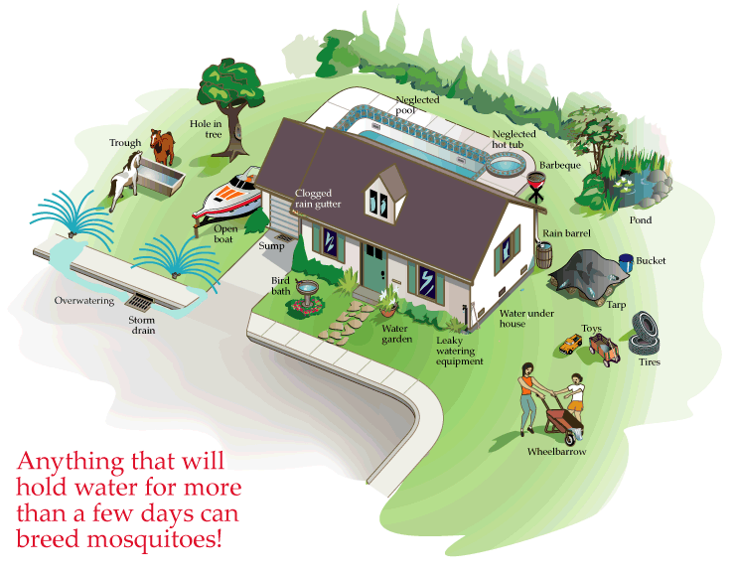
TIP & TOSS!

Slide 12
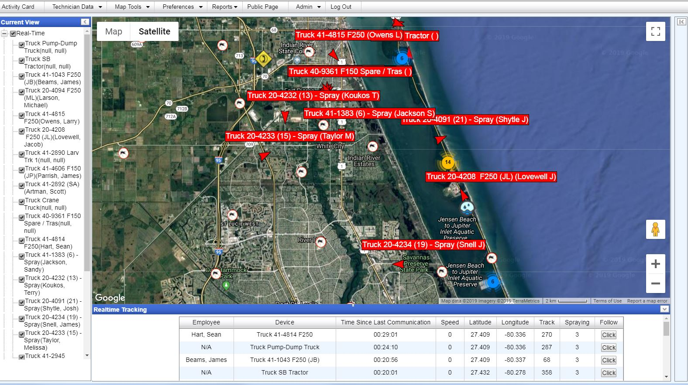
Finding Better Ways to Do Things

Slide 13
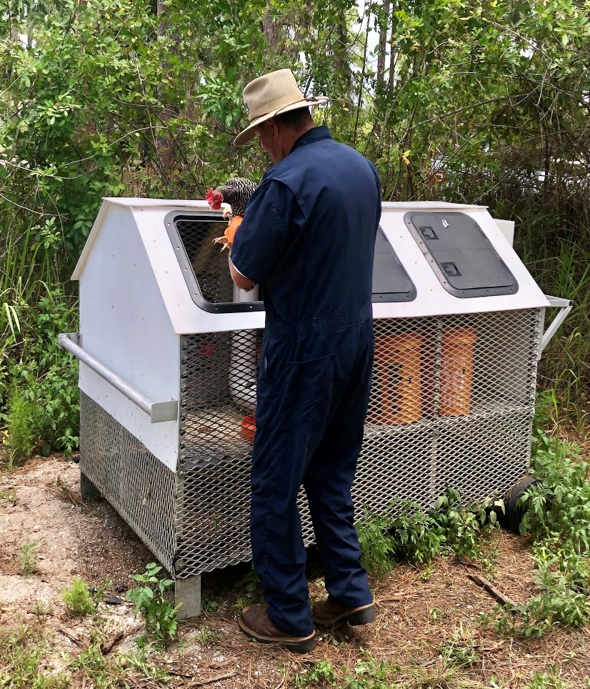
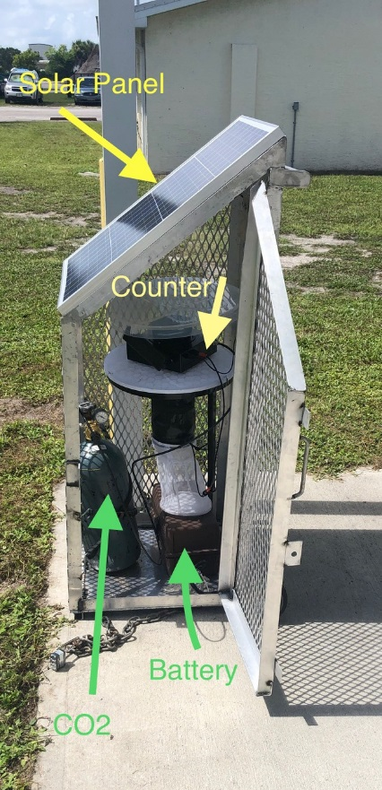
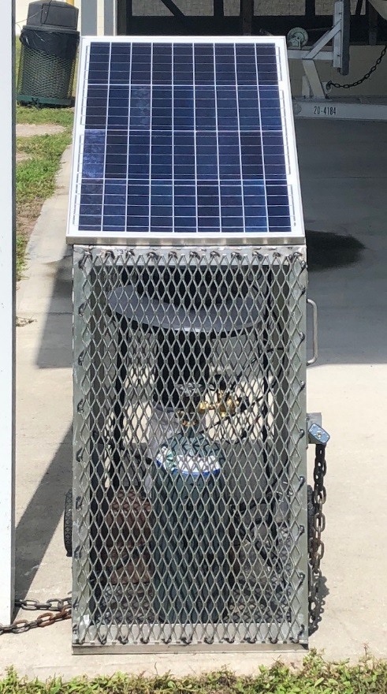
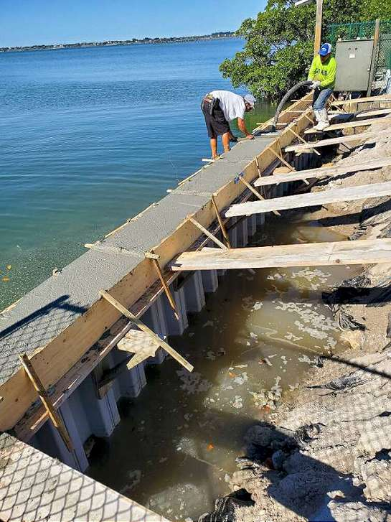
Innovation and Preparation
Impoundment Pump Station Stabilization
Solar-Powered Mosquito-Counter
Sentinel Chicken Program Improvements
Rebuilding Pump Stations
Notes:
We are constantly working to improve how we do things. We have a sentinel chicken program in which chickesn are placed in locations around the county to provide early warning of the presence of disease vectors such as West Nile and SLE. The chickens don’t get infected but develop antibodies that are measure through blood draws. We have improved in many ways, including building in-house these satellite coops that are efficient and offer protection for the chickens. In the middle you can see our new solar-powered mosquito counters that provide numbers in real time through web-program, workers are rebuilding the pumps that are used to fill up the mosquito impoundments.

Slide 14
2020-21 Department Initiatives
Continue to avert local transmission of disease-carrying mosquitoes
Fortify impoundment dikes to strengthen them against the increasing damage caused by sea-level rise
Replace damaged culverts to improve water exchange in several mosquito impoundments, helping to boost water quality and the health of salt-marsh habitat
Increase larviciding activities as a proactive response to improve the Department’s Integrated Mosquito Management
Improve Surveillance Program (Sentinel Chicken & Mosquito)

Slide 15
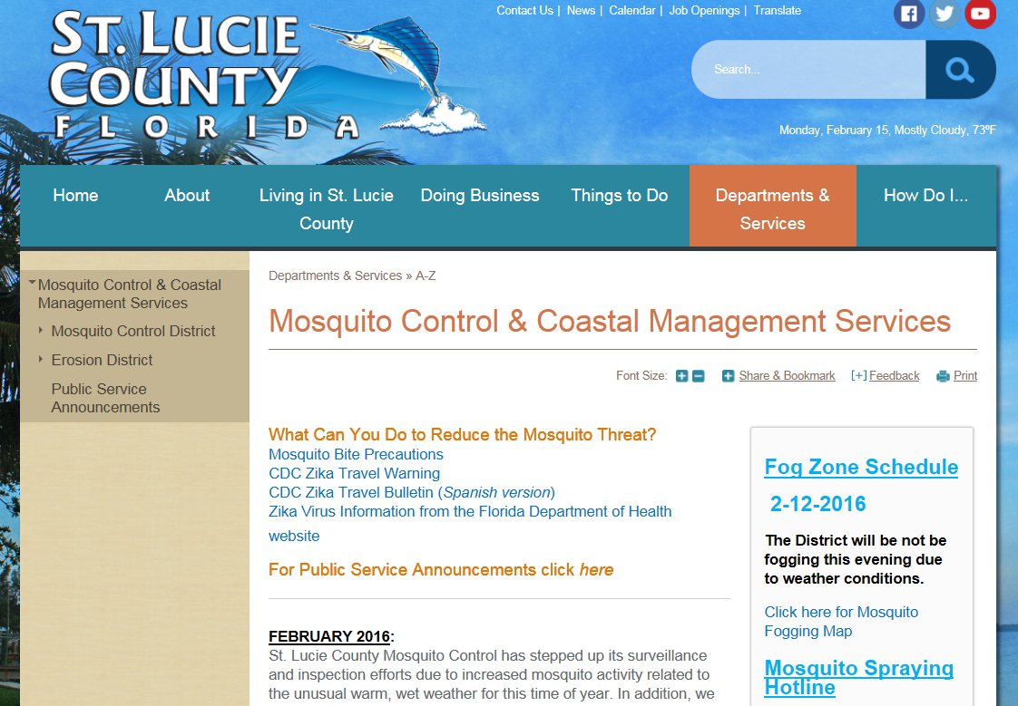
Information/Service
Service Requests:
772-462-1692
Mosquito Control website:
www.stluciemosquito.org
University of Florida/Institute of Food and Agricultural Sciences
http://stlucie.ifas.ufl.edu/

Slide 16
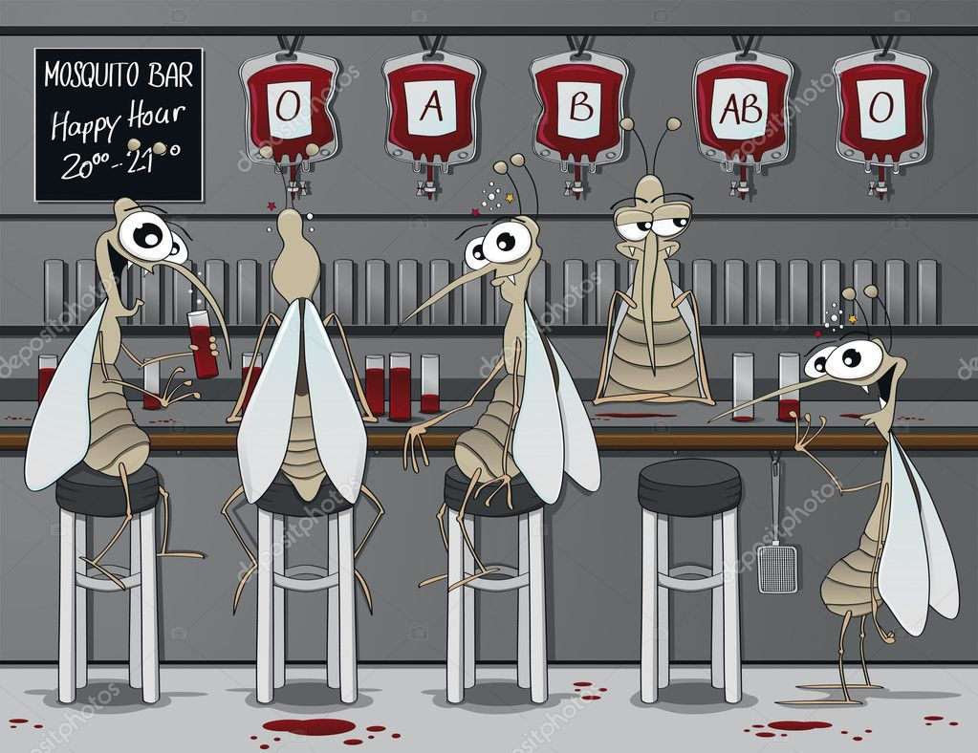
Questions?

