Slide 1
Fixing the Rigged System:
An update on our fight to end toxic Lake Okeechobee discharges
April 16, 2024

Slide 2
Mission:
To preserve, protect, and restore the only Everglades in the world

Slide 3
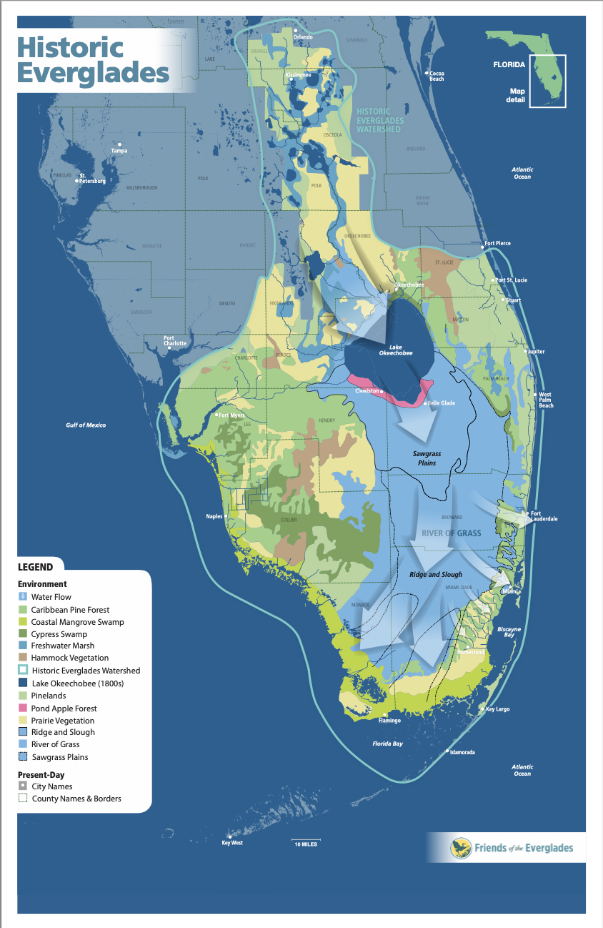
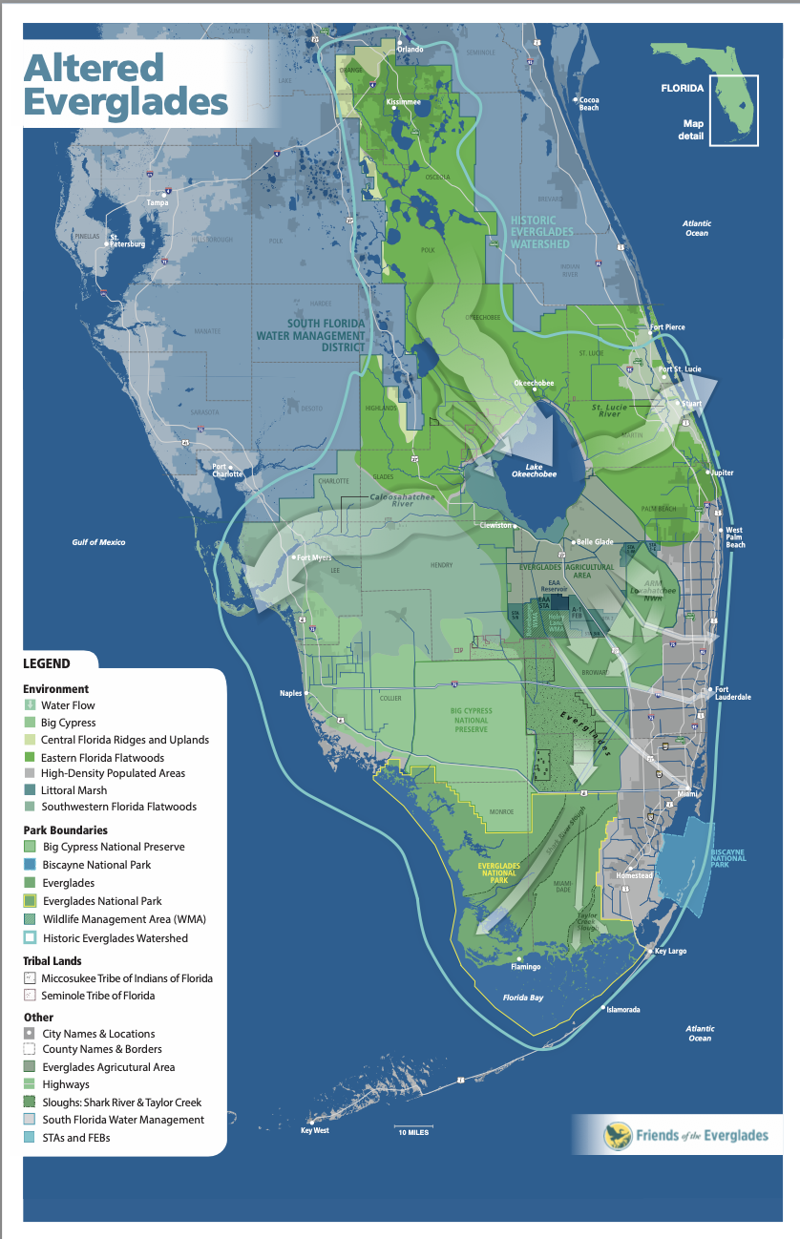

Slide 4
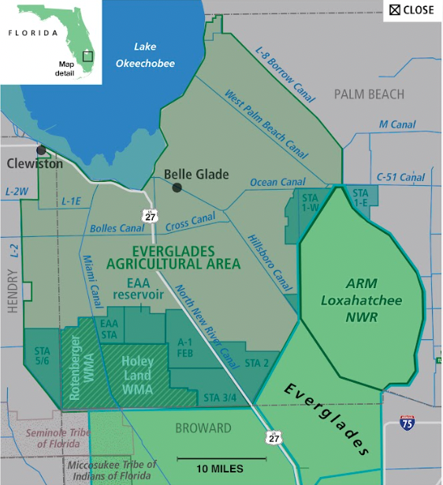
Sugarcane in the EAA gets near-perfect drainage and irrigation via taxpayer-funded marshes (STAs)

Slide 5
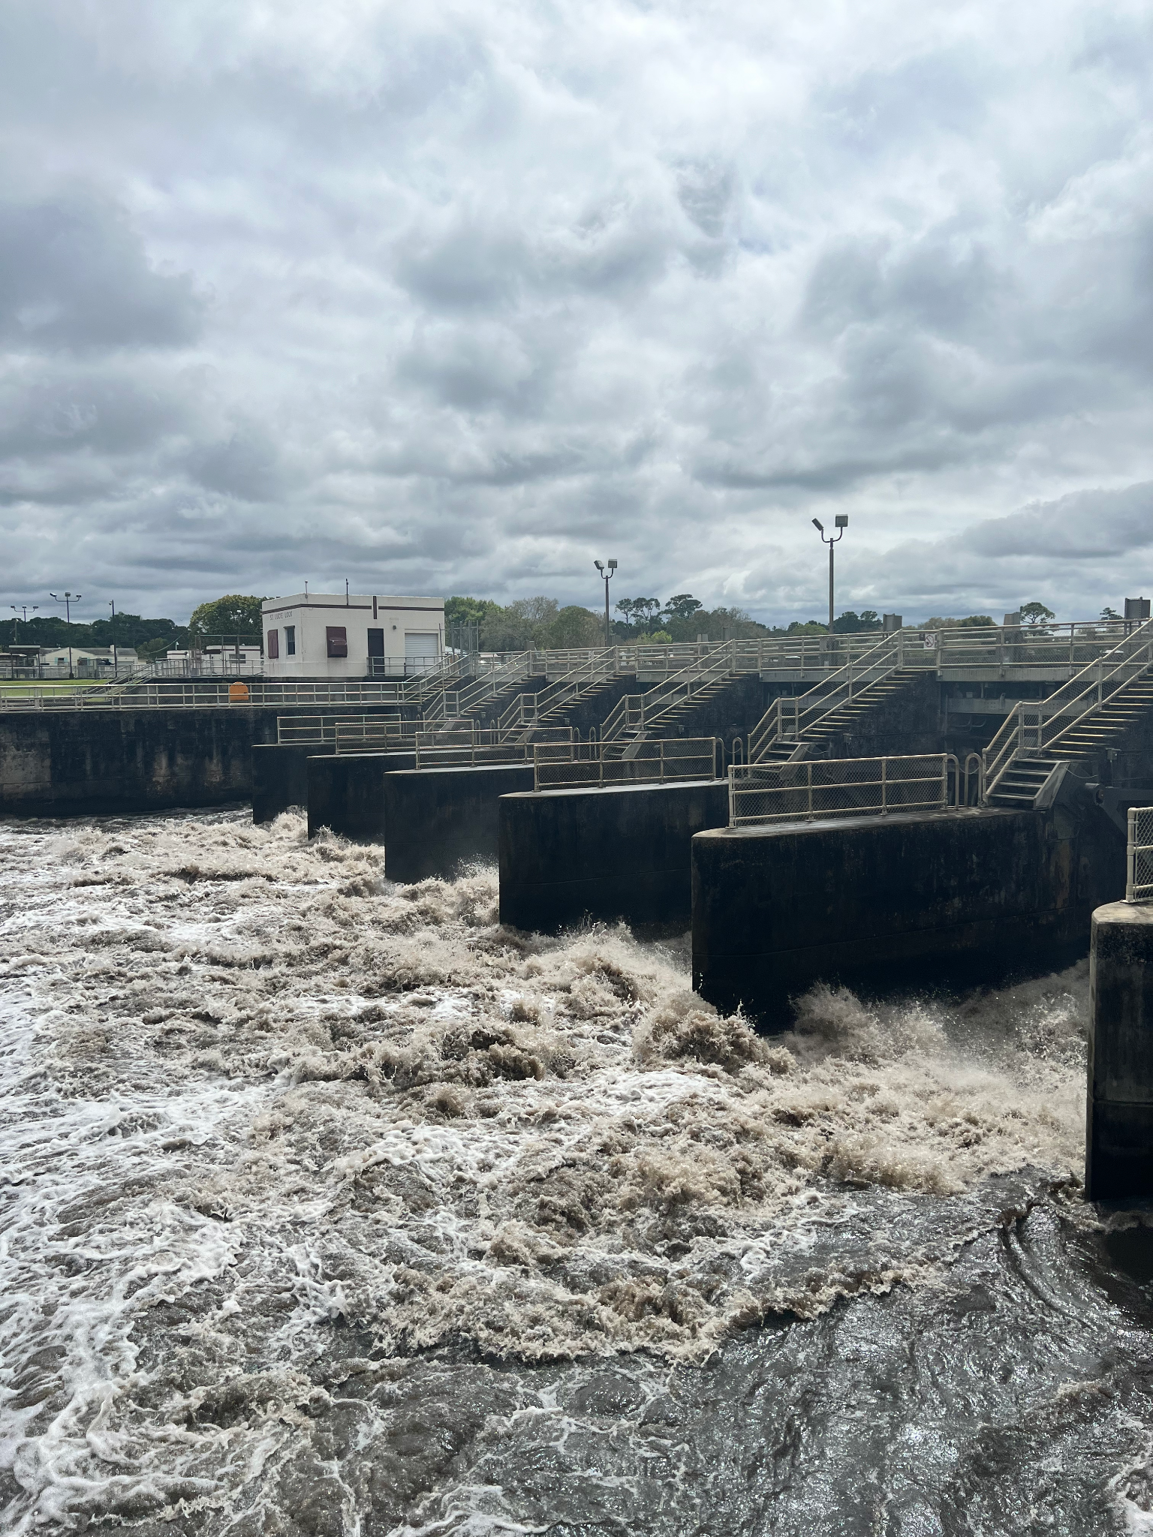
Consequences of a rigged system
Damaging discharges to the St. Lucie River, Caloosahatchee River, Lake Worth Lagoon. Army Corps of Engineers opened gates on Feb. 17

Slide 6
Notes:
This is what it looked like a few weeks later.

Slide 7
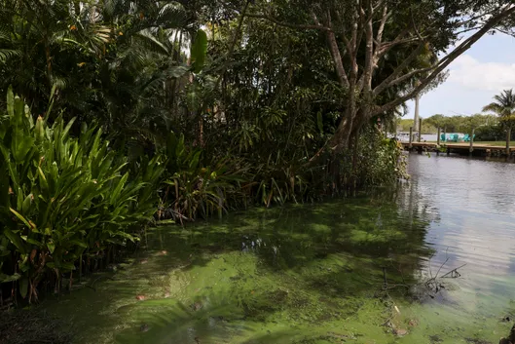
CRYSTAL VANDER WEIT/TCPALM
Notes:
Easter weekend brought headlines that our river is toxic

Slide 8
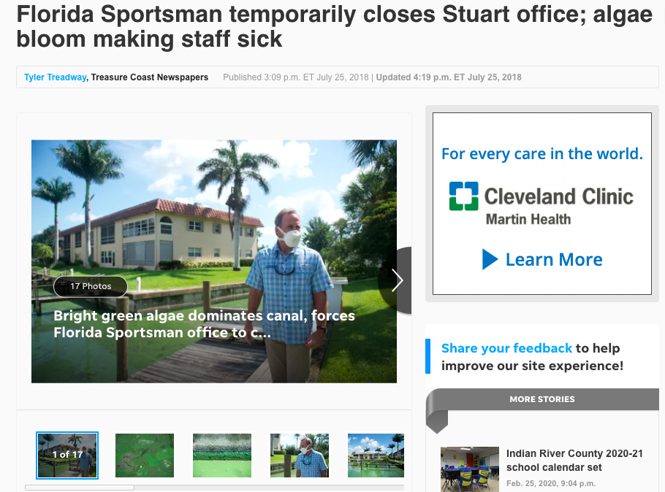
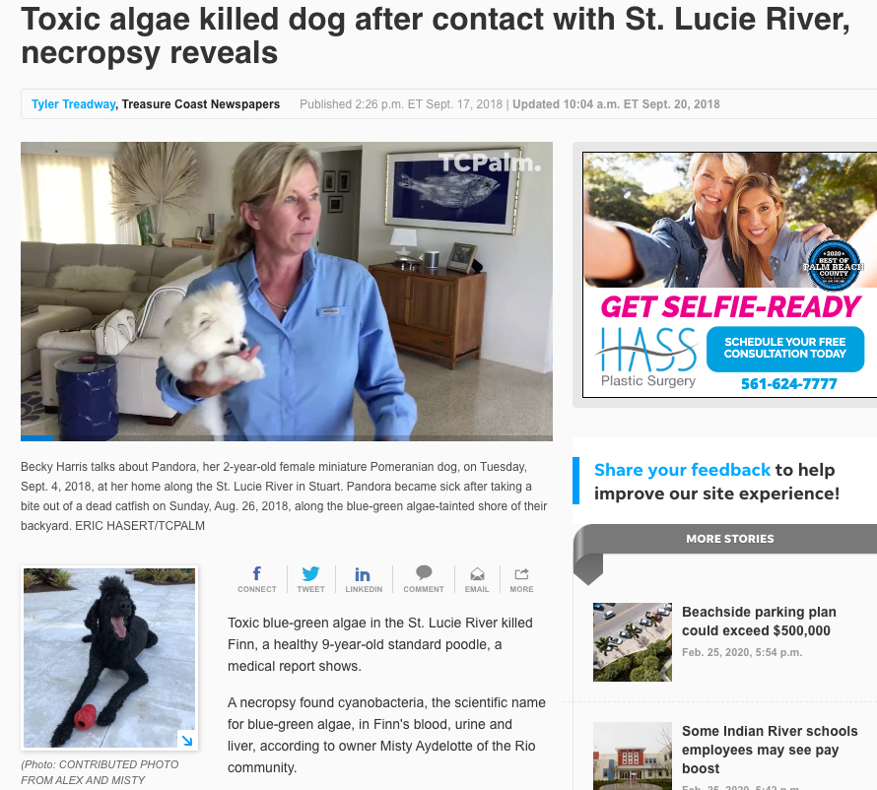
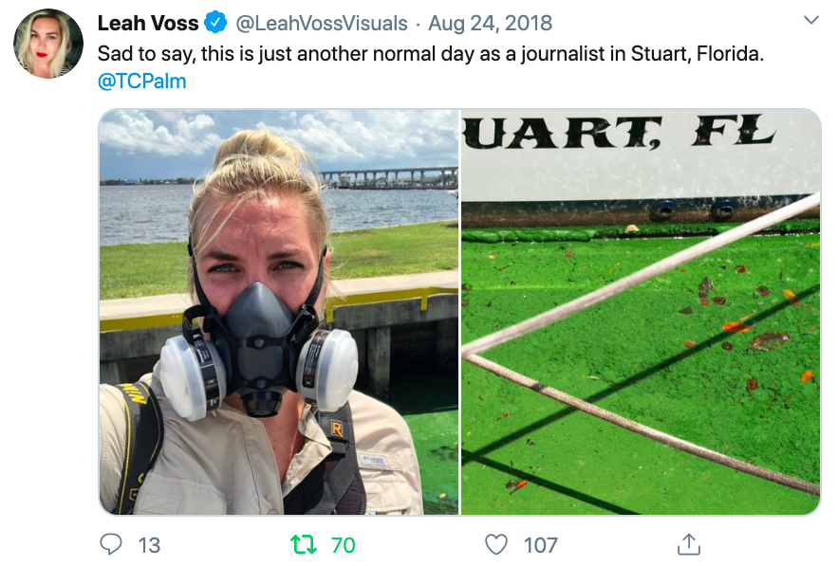
We’ve seen this (horror) movie before
Notes:
Health concerns

Slide 9
Positive signs
Notes:
This indicates a cultural shift from ACOE. It has happened more often in recent years. A new Lake O management plan will take effect this summer that, for the first time, acknowledges the risk of toxic algae and the need to send more water south to the Everglades.

Slide 10
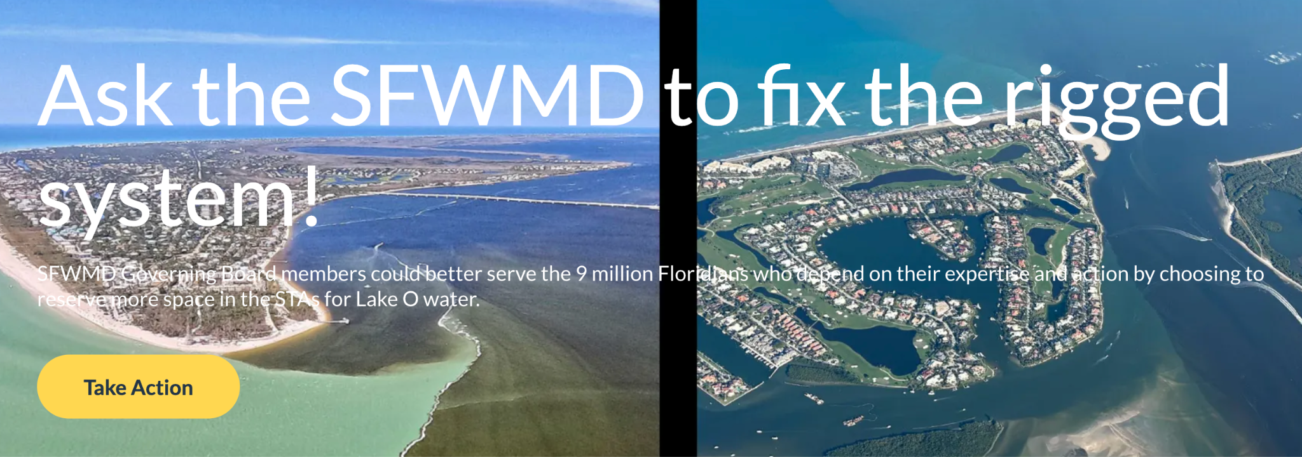
Grassroots advocacy drives change
Notes:
Another positive sign. Grassroots advocacy for near-term solutions – more than 800 messages sent to Governing Board

Slide 12
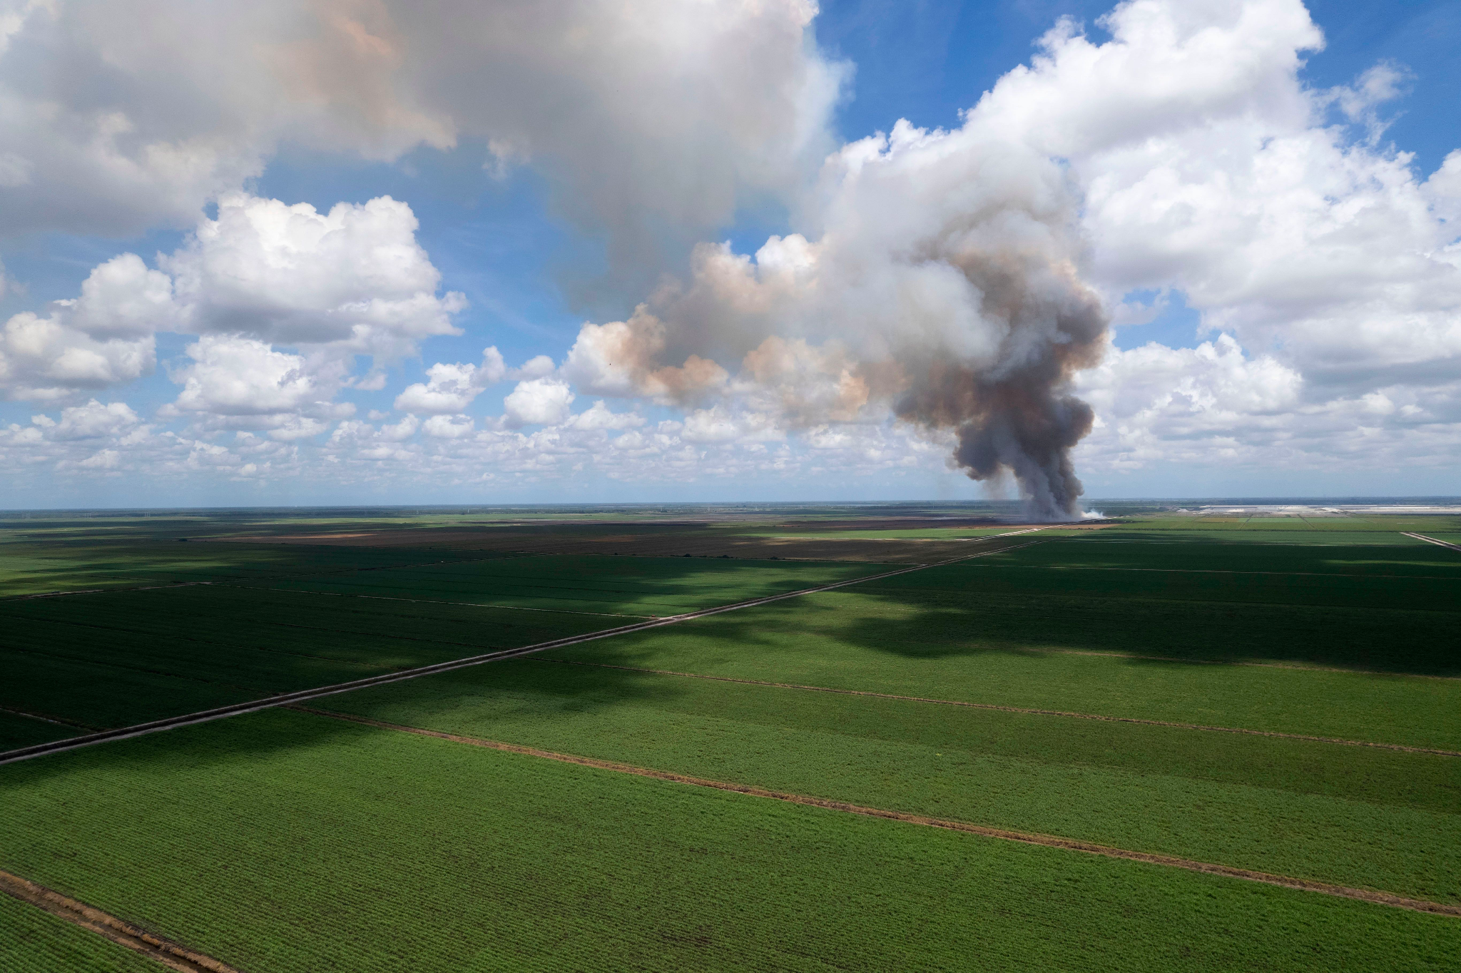
Finish the job south of Lake O
(more land)
The long-term solution
Notes:
We still have work to do. When Joe Negron was senate president, we knew we needed 60k acres for the EAA Reservoir. We ended up with about a quarter of that.

Slide 13
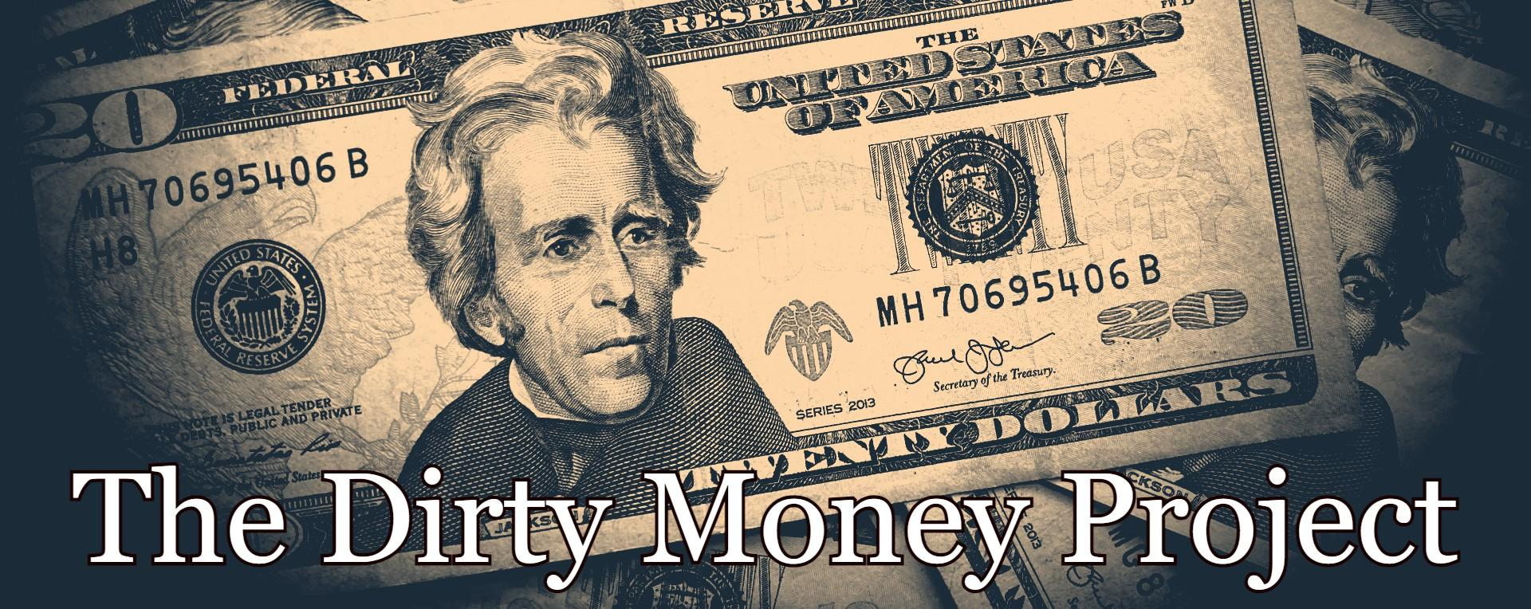

Slide 14
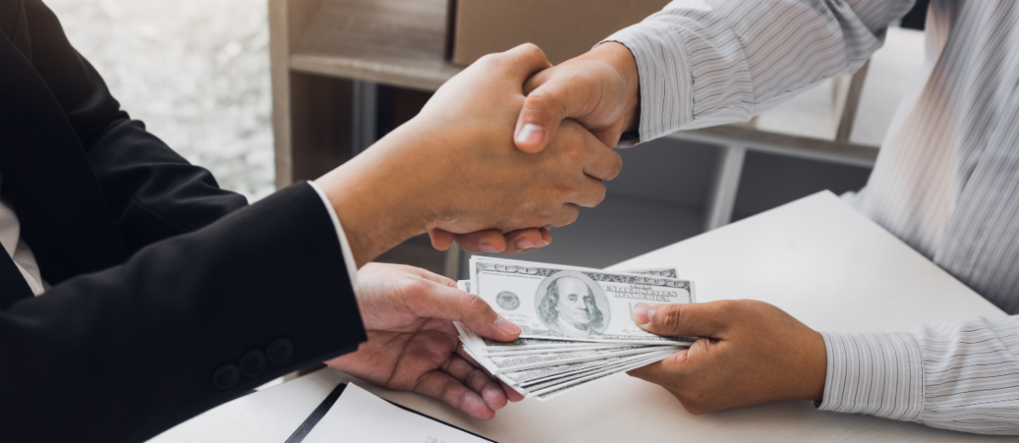
Problem statement:
A vast tide of special interest money has overtaken our politics. To reverse the tide, it is critical to trace the flow of money from polluting industries and other
special interests to PACs, between PACs, and to candidates and elected officials.
Often PACs are nested like Russian dolls. The “legal money laundering” between PACs, often using the same registered agents, requires researchers to know who and what to look for.
The Dirty Money Project will address this problem, focusing on South Florida.

Slide 15
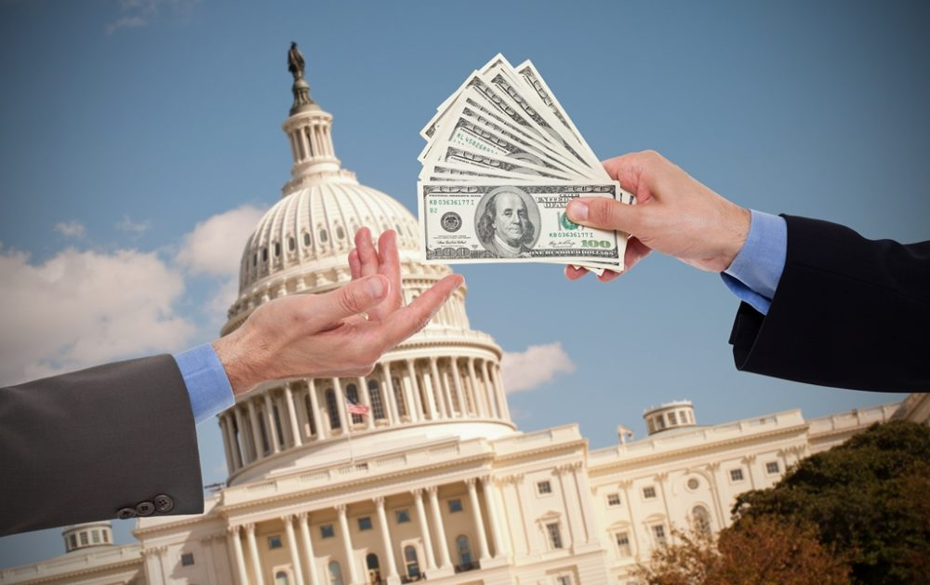
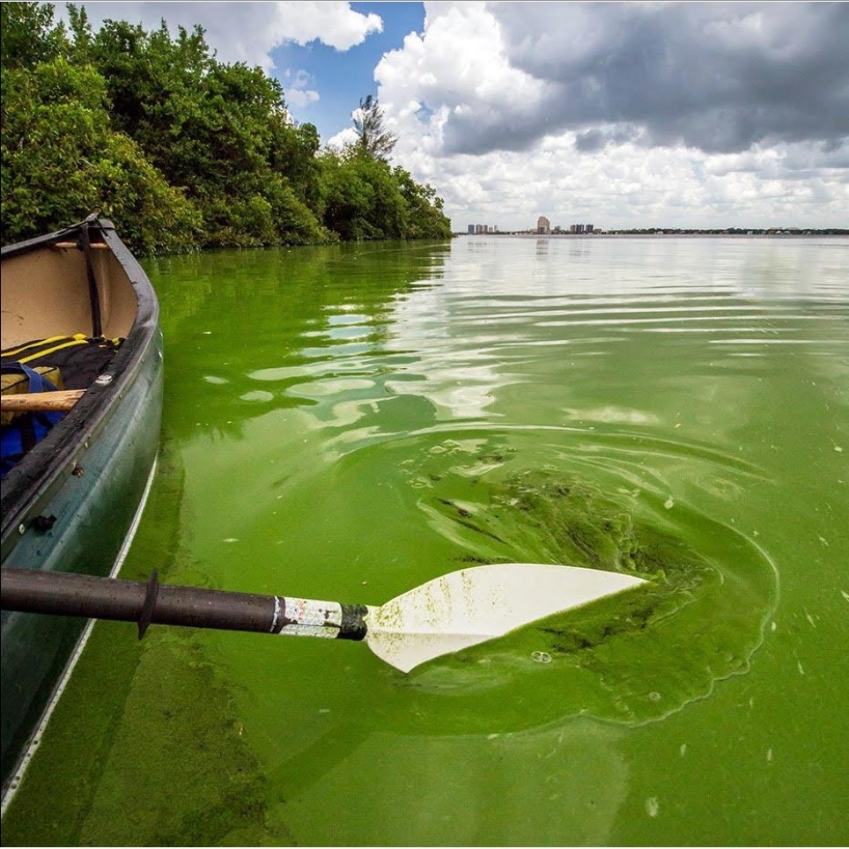
Dirty money to dirty politicians = dirty water
=

Slide 16
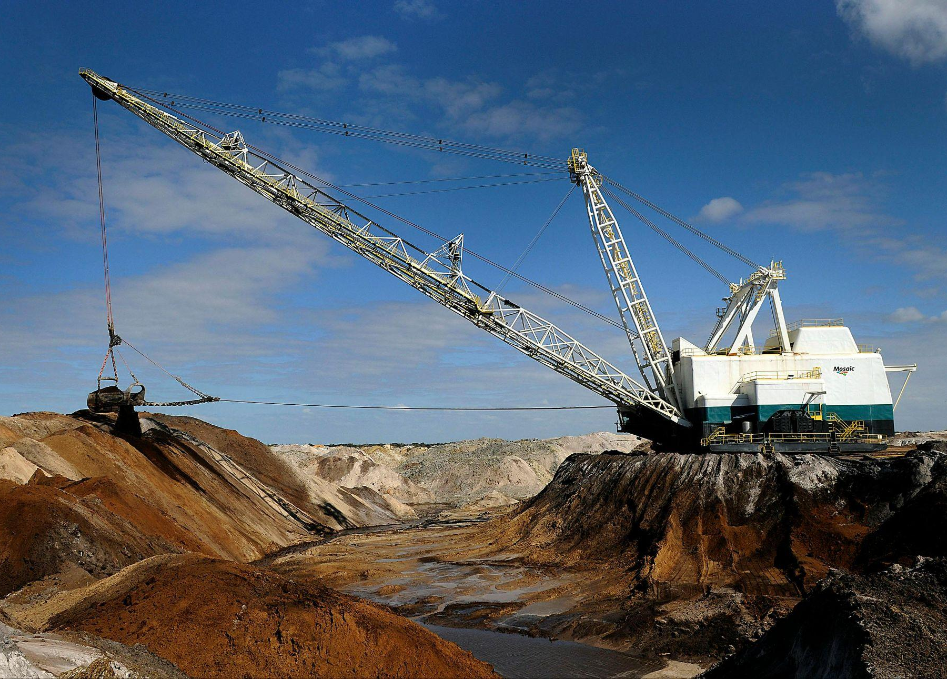
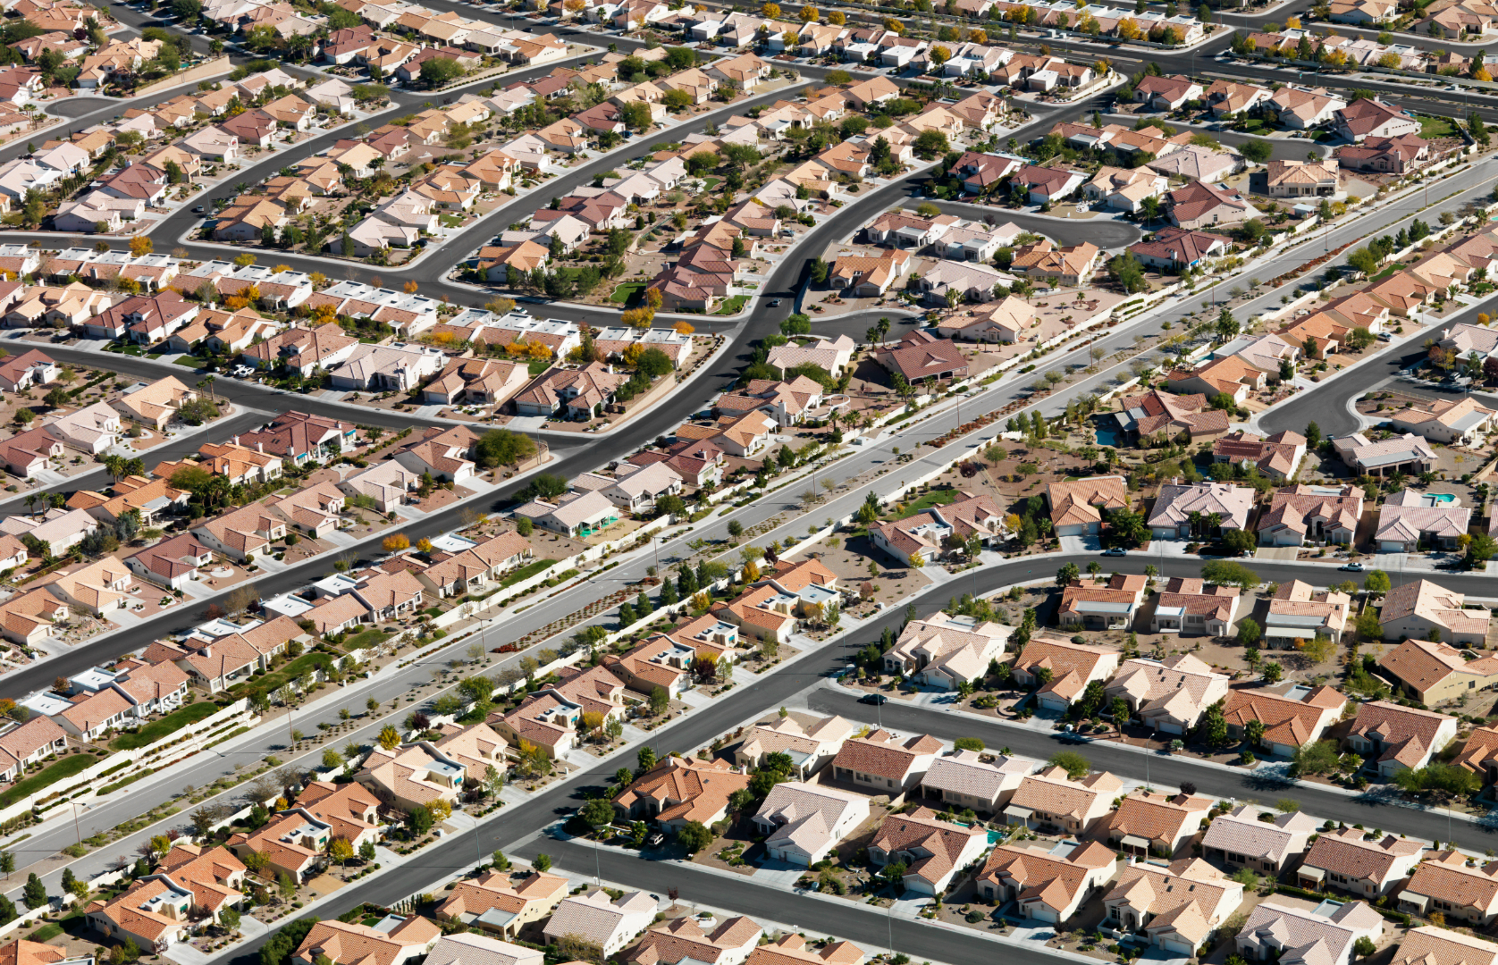
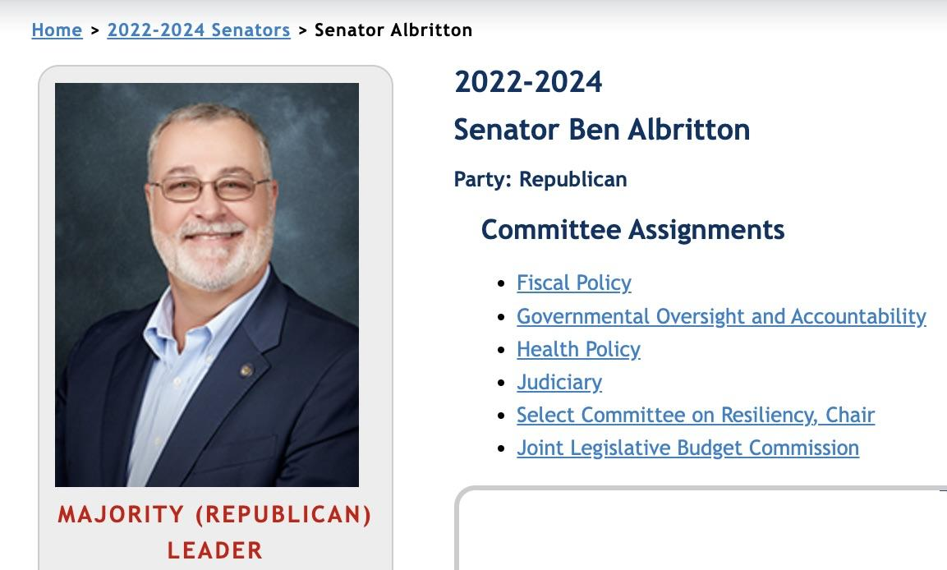
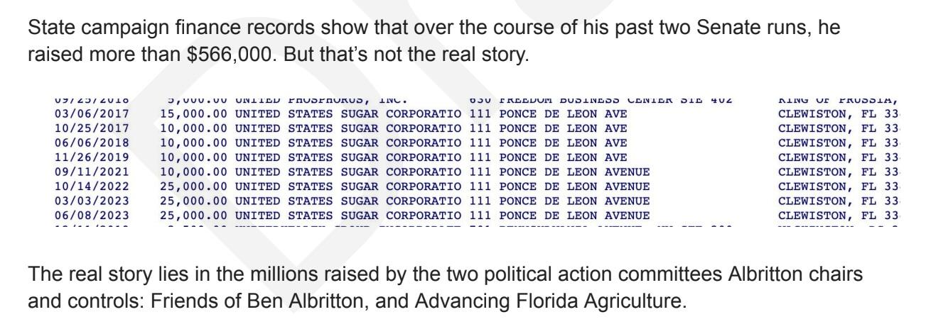
Who’s giving dirty money - and who’s getting it

Slide 17
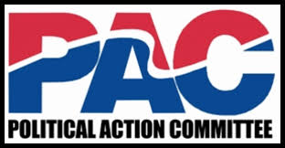
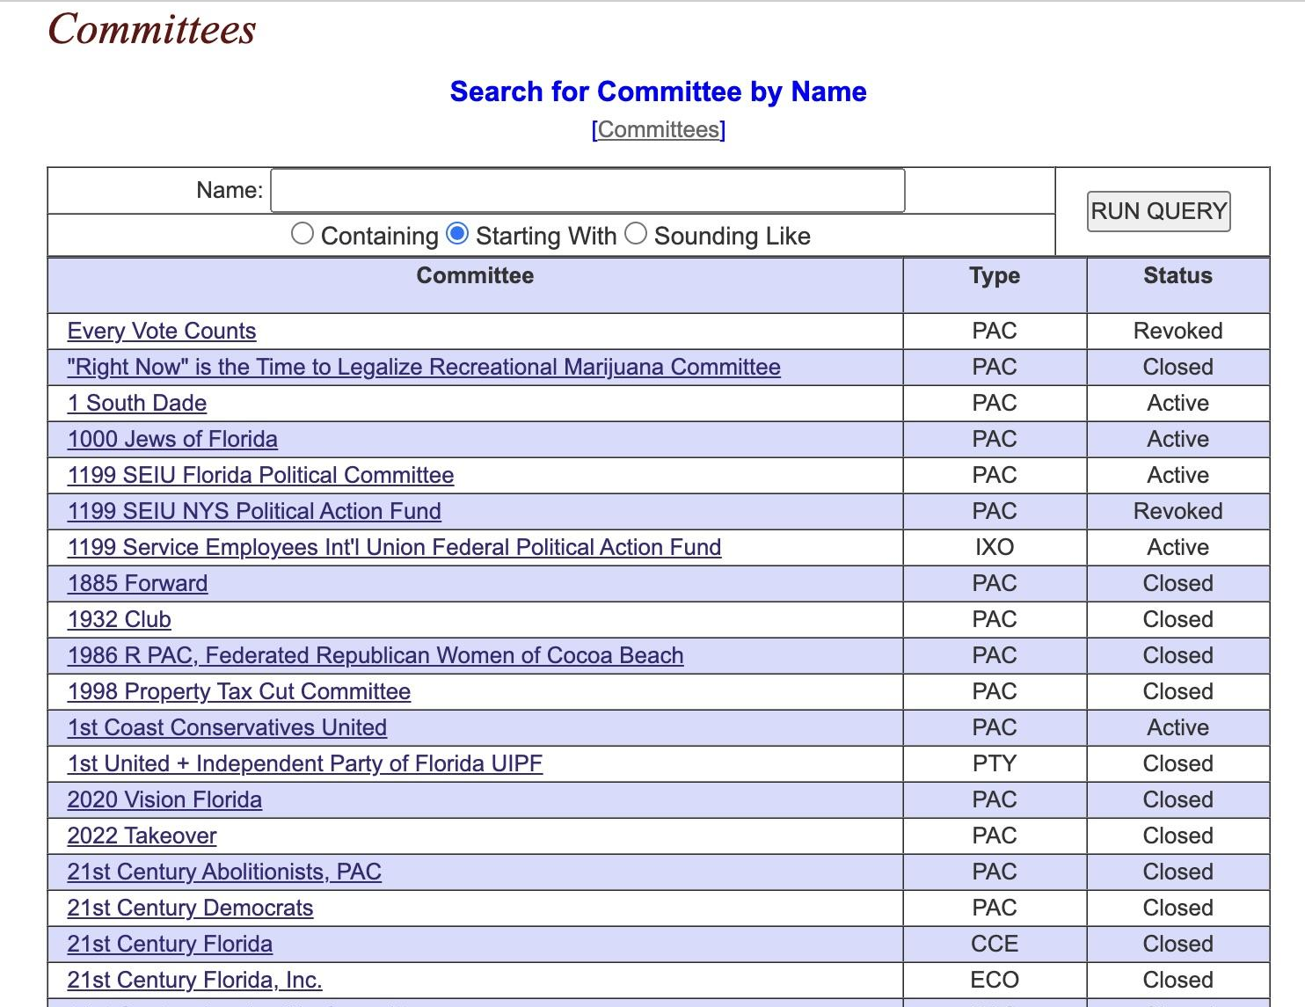
Political Action Committees - down the rabbit hole

Slide 18
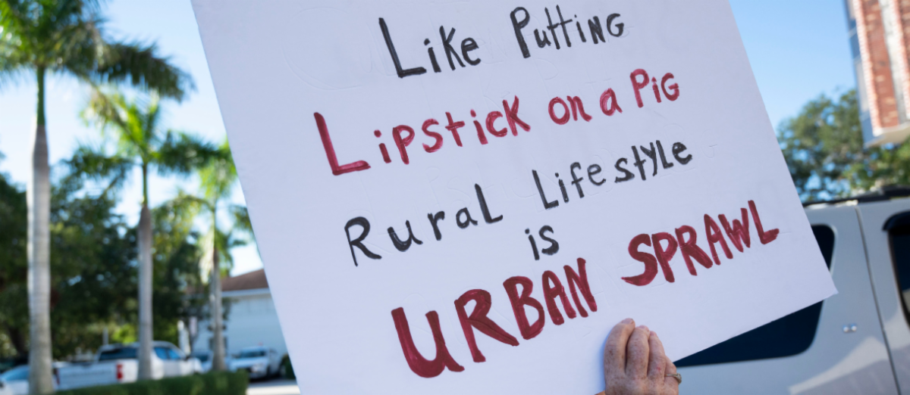
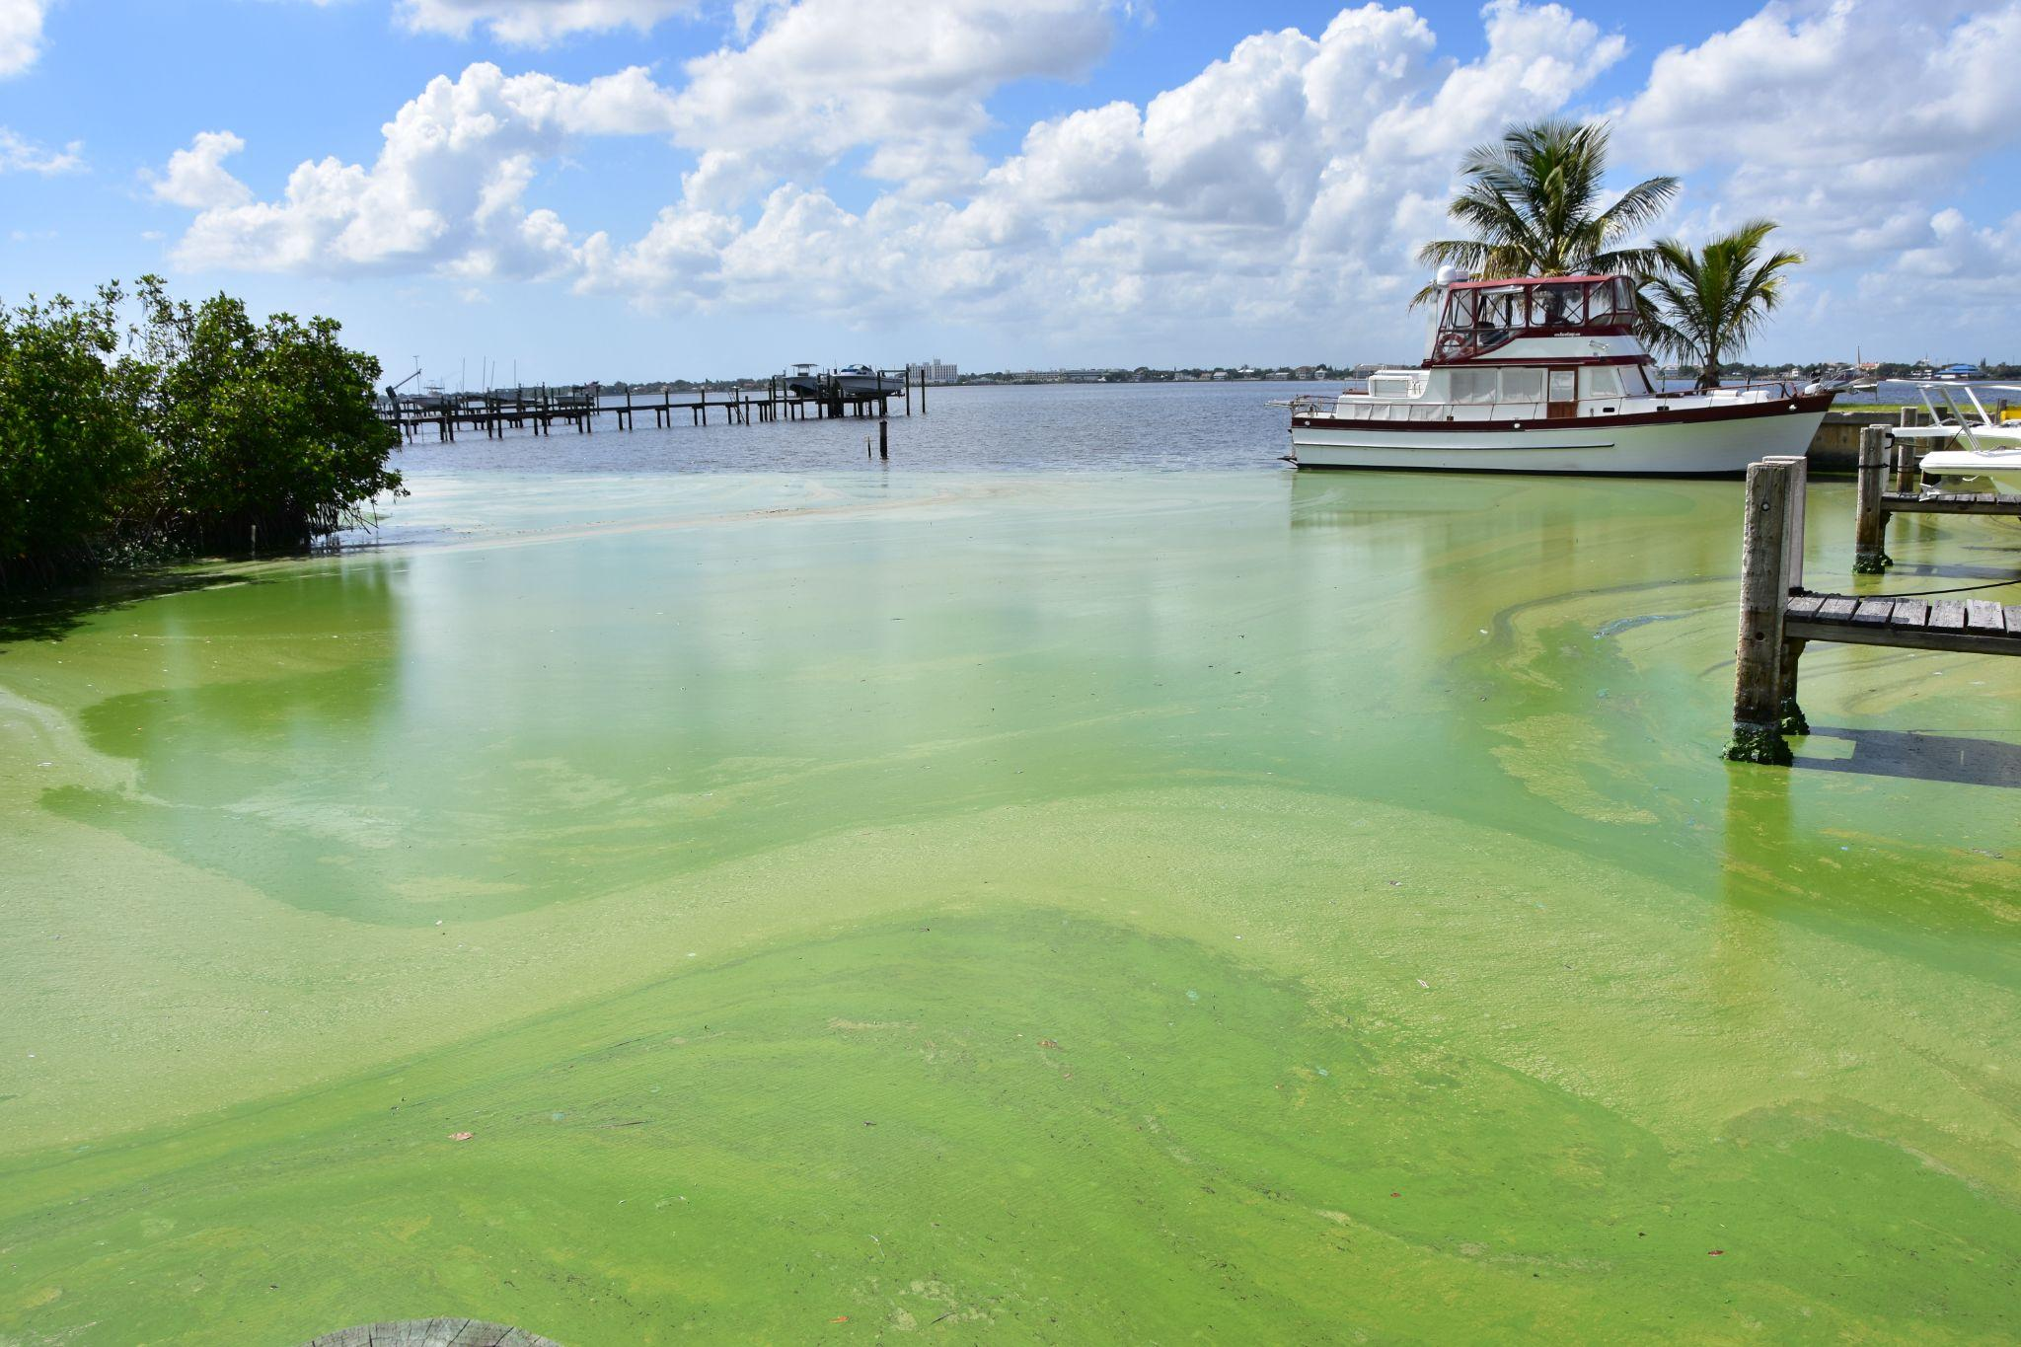
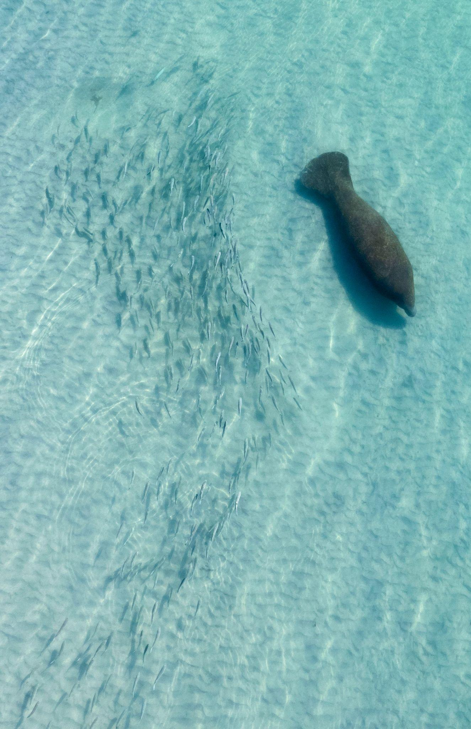
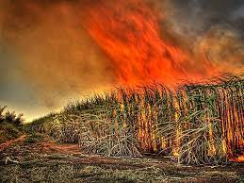
Why is this happening? Dirty Money tells the story

Slide 19
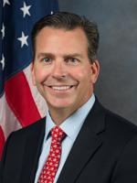
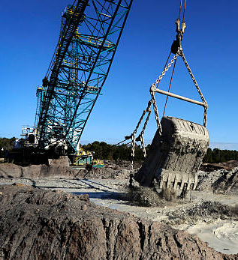
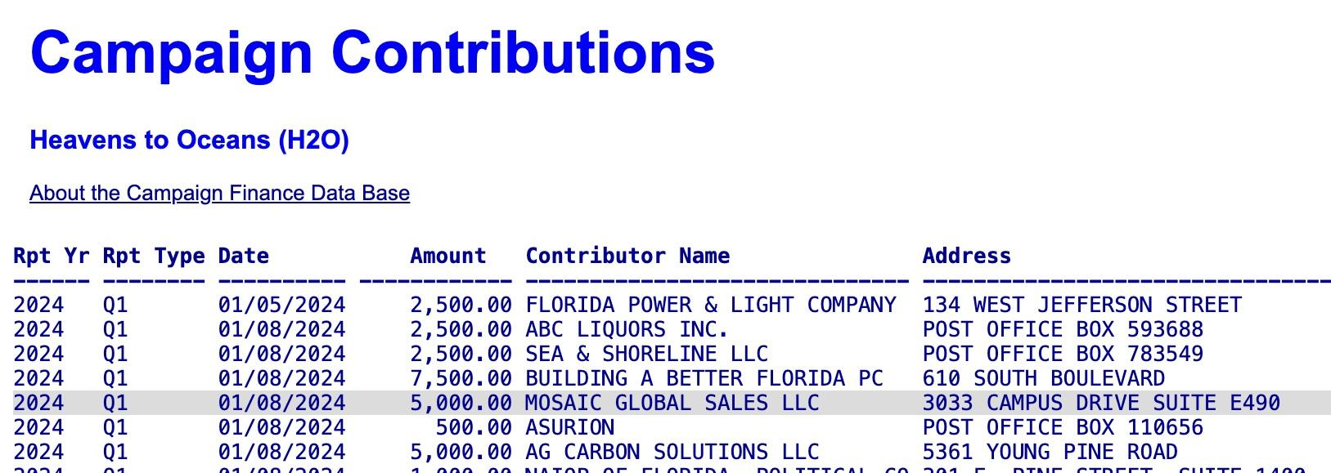
Case study - HB 789, ‘Toxic Spill bill’

Slide 20
Project goal: An informed electorate is the only durable protection for democracy. We will use our findings to inform the public and make a compelling case to voters, the media and decision makers that dirty money has a disastrous effect on Florida’s environment, economy and citizens.
Ultimately, we seek to make “dirty money” so toxic even dirty politicians won’t touch it.

